Slide 1
Data upload to the Brassica Information Portal
Workshop- uploading population and trial scoring data
Annemarie Eckes
Data Curation, Plant Phenotyping
Notes:
We are developing the Brassica Information Portal as a resource that collects, integrates and analyses phenotypic data from pre-breeding experiments on Brassica crop species.
The Portal will facilitate Brassica crop breeding with a data-driven approach: The data collected from phenotyping experiments are made accessible and available in a standardised manner. This data can be integrated with genotypic information. In the future, associative analysis tools will enable on the fly analysis between traits hosted in the Portal and external genotypic information.

Slide 2
BIP and ontologies
Communication, interpretation, analysis, knowledge transfer
Taxonomy Ontology (GR_tax)
Plant Ontology (PO)
Crop Ontology (CO)
Internal nomenclature for populations, trials, accessions and plant scoring units
Notes:
Ontologies for the BIP are important for harmonizing the annotation of phenotypic
-> to support data accessibility and discovery.
Lack of standards in nomenclature in Brassica. -> needs to be identified, discussed, improved, reviewed.
“Without either a nomenclature or information, which provides the equivalence links between trait descriptions, it is hard to compare information from Quantitative Trait Loci (QTL) and association studies in a way that permits systematic transfer of knowledge about genotype-phenotype relationships among crops or between crops. “
A successful implementation of Ontologies for Brassica will facilitates comparison
Systematic knowledge transfer about genotype-phenotype relationships among brassica.

Slide 3

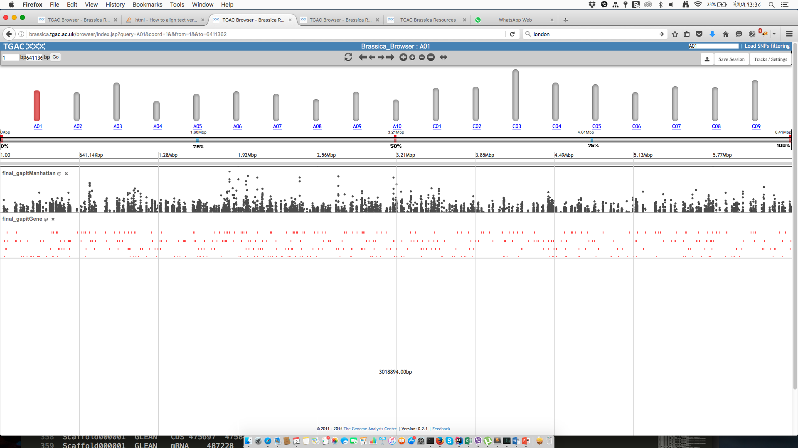
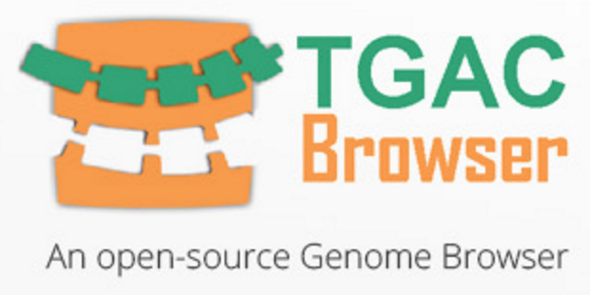
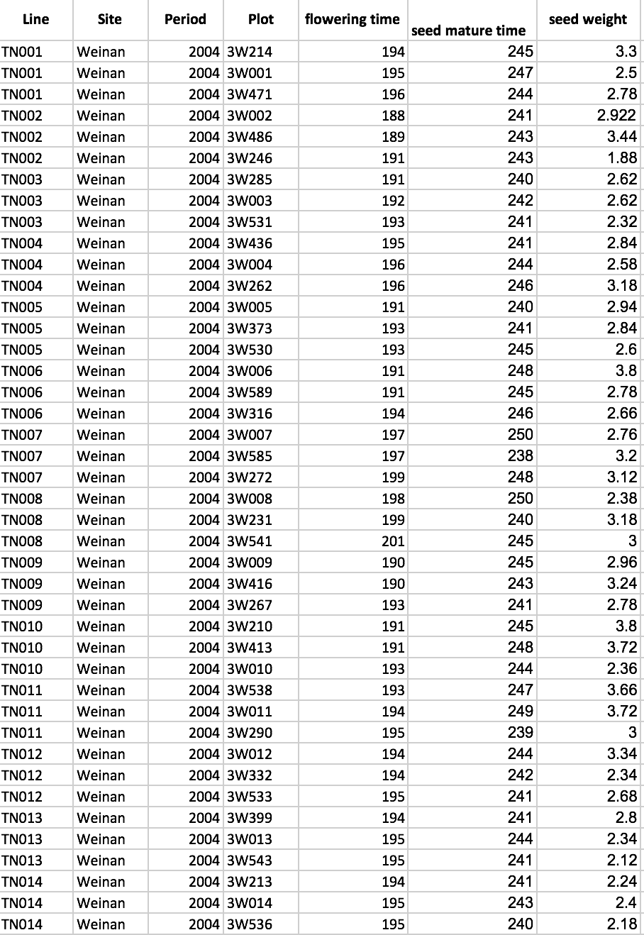

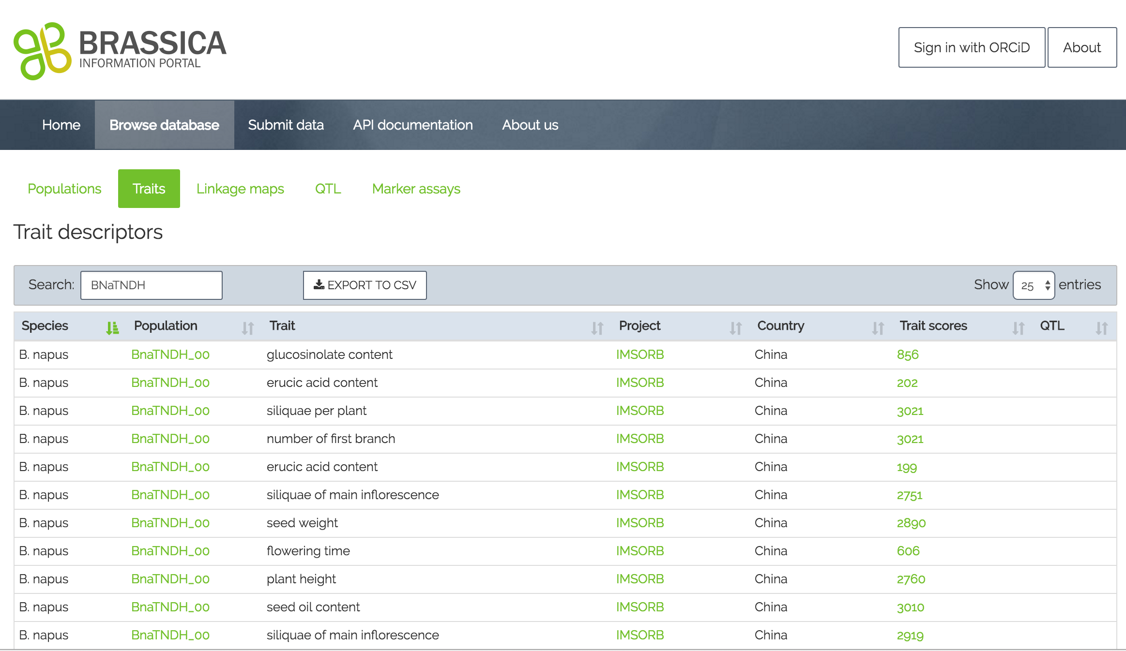

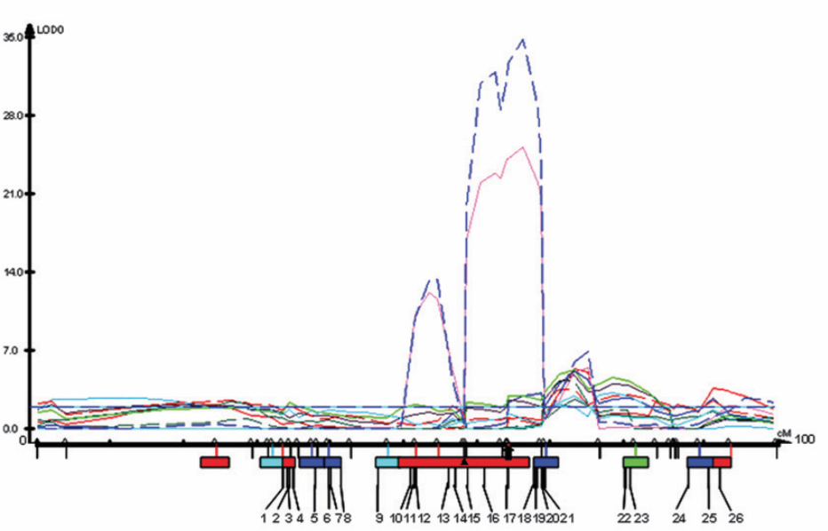
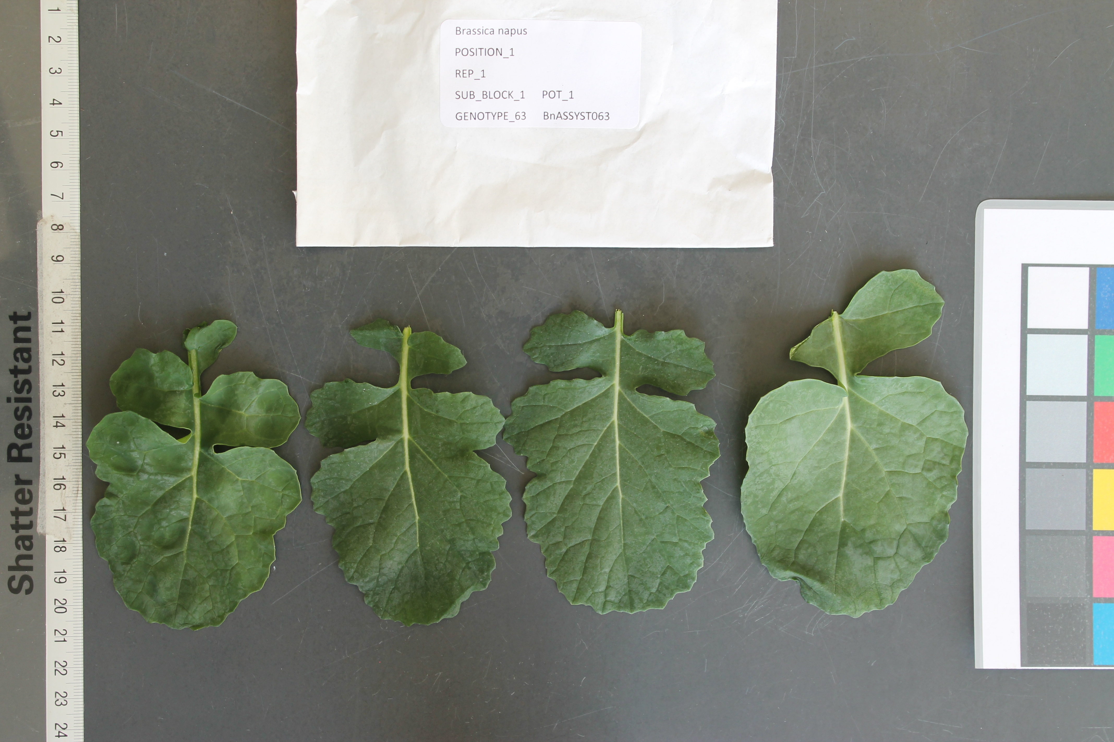


BIP integration with other resources
Extended submission, cross-linking, analysis, publishing
Notes:
The original “direction”/way of Using the BIP is linear: Data can be stored and accessed for downstream analysis. It is simply a “repository” of trait scoring data for Brassica crops.
But we are working on extending and cross-linking its functions, some of which I will present later. For example, we have made it possible to submit image names and draw from CyVerse as a default resource to cross-link the image names submitted to BIP.
Extension: make user submit image data alongside with measurements. The images will automatically be stored in CyVerse as opposed to the user having to do this manually.
The user can now submit sequence identifiers from SRA with the submission, which are automatically cross-linked with the corresponding entry in NCBI.
It is now possible to access the BIP via the TGAC browser. The feature allowing this is dependent on background data uploaded to the Browser by the administrator.
In the background of the brower, SNP information for the RIPR population is loaded. People interested can select lines carrying certain SNPs of interest and compare them with lines not carrying these SNPs. During this analysis, the user can look up the line in the Brassica Information Portal and see any related information about the line there ( e.g. registered trait measurements, origin, Cultivar name, all experiments using that line, etc.., )
-Note that this feature is currently only accessible as a service for the RIPR project, as it is sensitive data.
Legacy data sequences- where possible are cross-linked with Ensembl/ NCBI.
We are working with the CyVerse team to integrate their analytics tools with the BIP.
Latest developments were to obtain DOIs for datasets submitted to BIP.

Slide 4
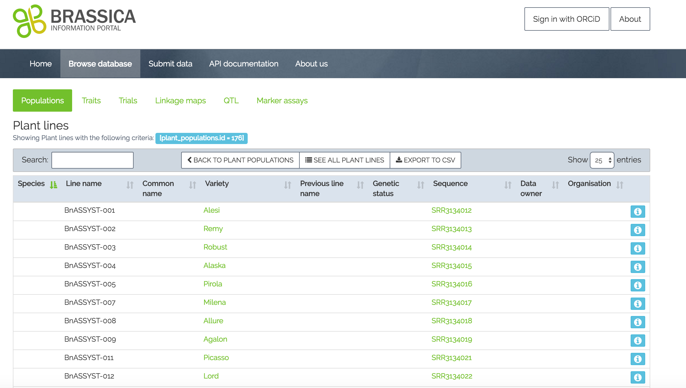
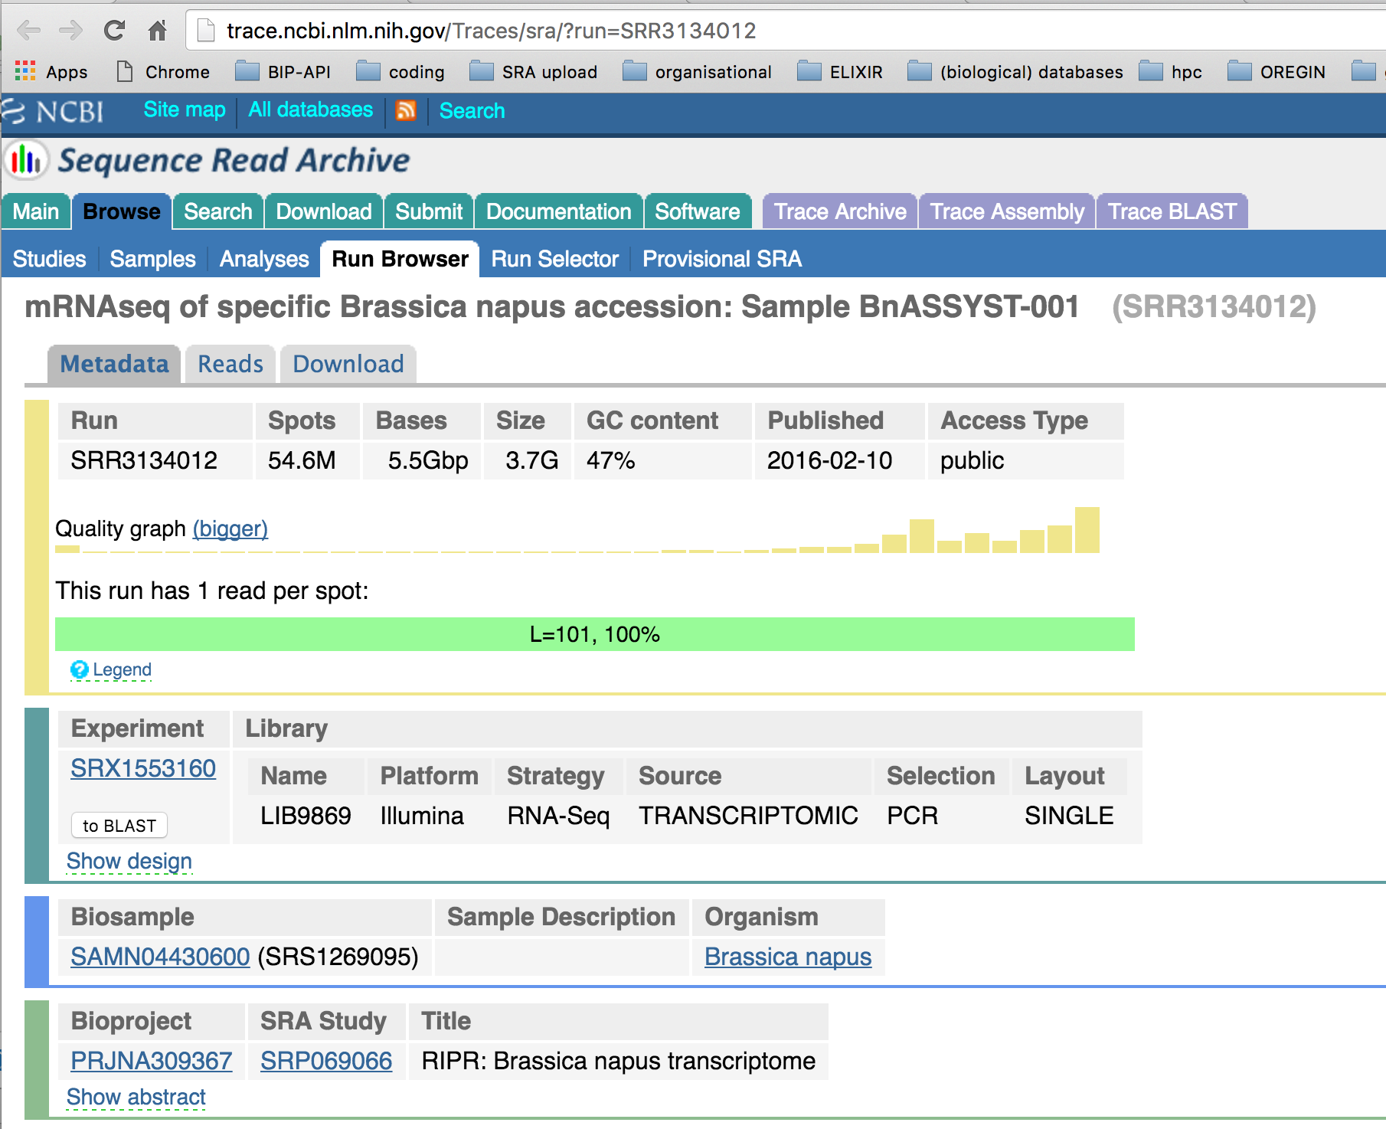
Your Sequence Identifiers in the BIP
RIPR population and trait data uploaded, cross-linked with sequences and images.
Notes:
It is possible to submit SRA sequence identifiers along with your population data.
This slide shows successfully submitted plant line information and provides a cross-link to the NCBI sequence database.

Slide 5
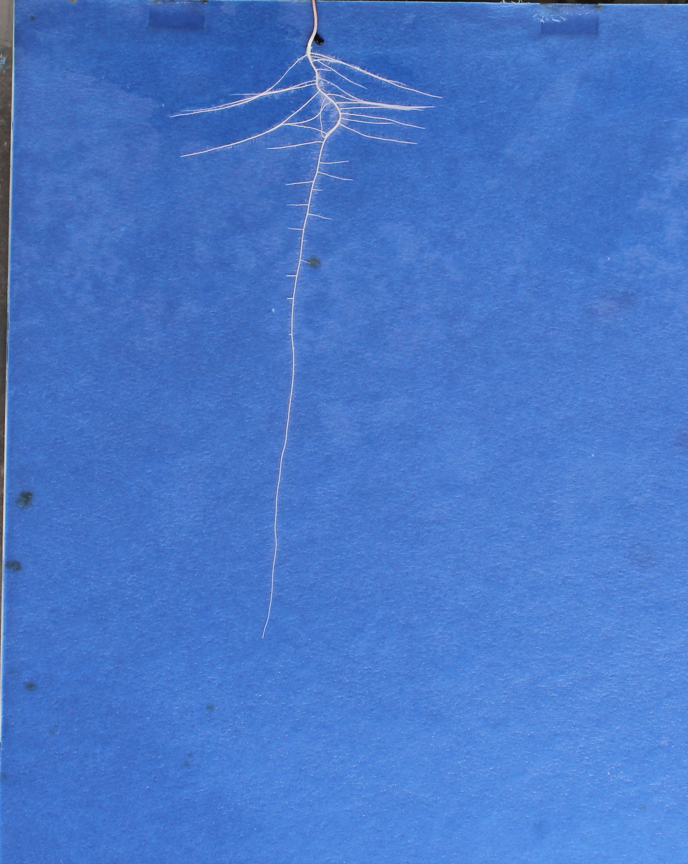
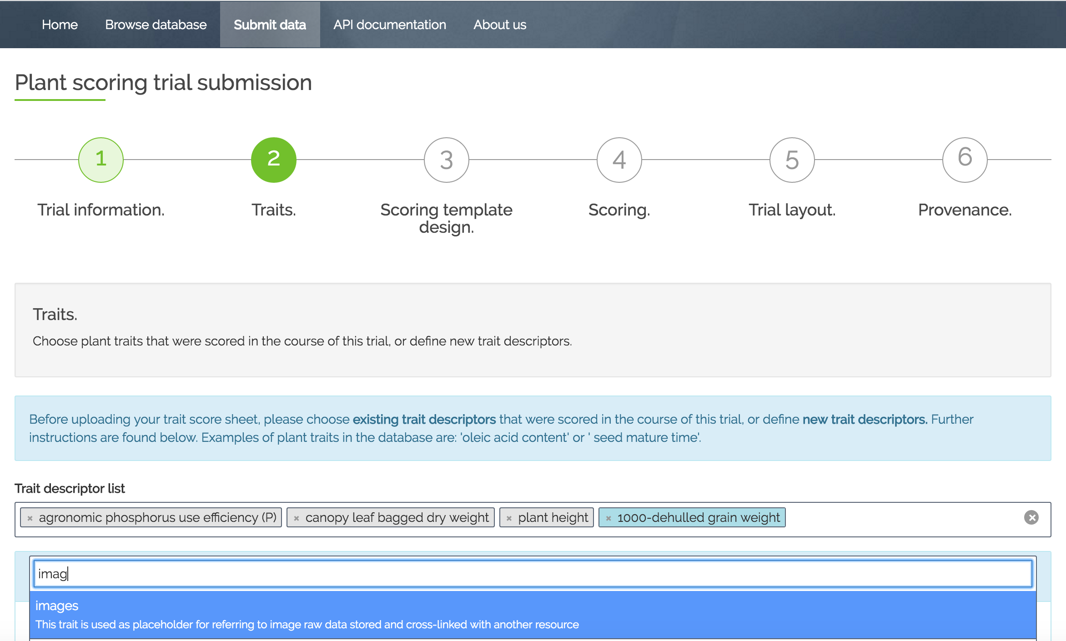
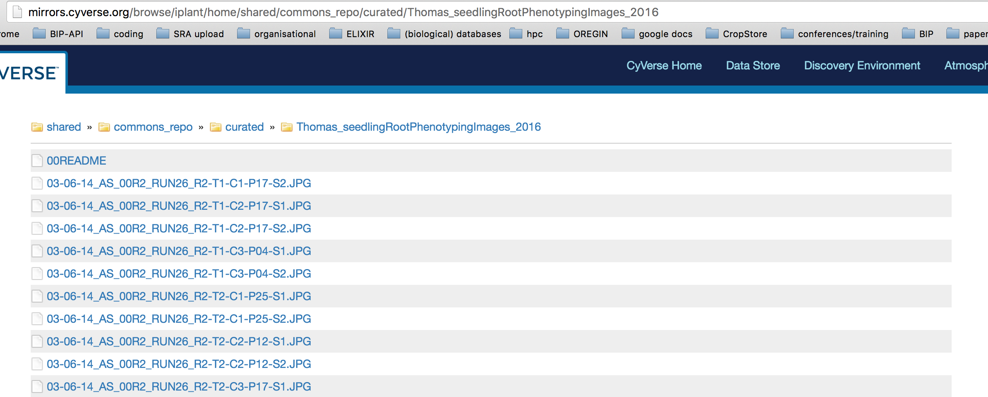
Cross-linking images to the BIP
Upload of image data to CyVerse: provide url in BIP submission
Get help upload images to CyVerse
add “image” trait in trait scoring template generation
Insert image name and url into scoring template
Default address, presented by BIP:
http://mirrors.cyverse.org/browse/iplant/
+
Your specific image location post-Cyerse publishing:
home/shared/commons_repo/curated/Thomas_seedlingRootPhenotypingImages_2016/03-06-14_AS_00R2_RUN26_R2-T1-C1-P17-S2.JPG
“This trait is used as placeholder for referring to image raw data stored and cross-linked with another resource.”
Notes:
Get help uploading images to CyVerse using the Brassica Information Portal account. Once the images are uploaded, it is possible to receive a DOI for the lot. This requires the submission of certain metadata. We can also help you with that.
Treat the image as a “trait” and select the image trait when choosing all your other traits scored
Insert the image name into the trait scoring template that you download during trial data submission, the image should be the raw data associated with the measurements uploaded to the BIP in this submission. This means that the image needs to correspond to the exact accession and the measurements derived from it. Here: Image data for total, Primary and alteral root length from accession Nottm are derived from the image that can be called from this link.

Slide 6
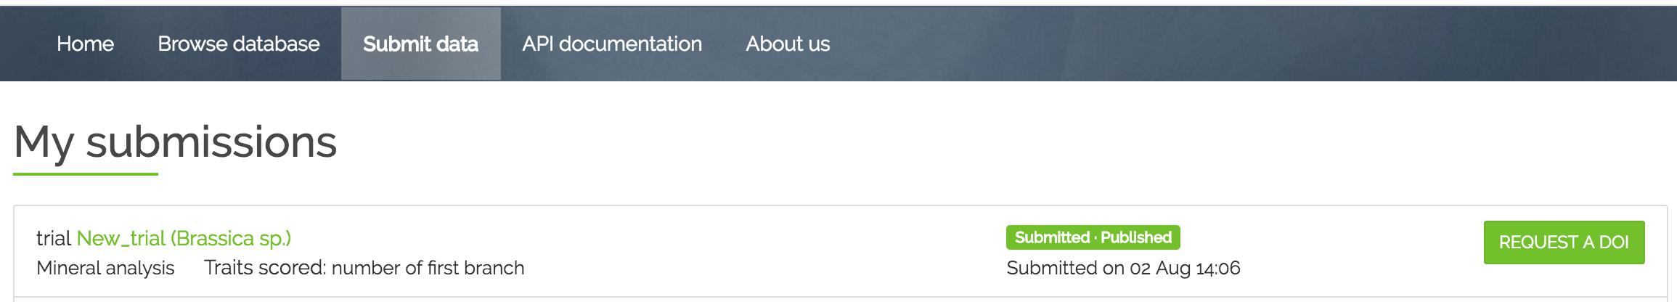
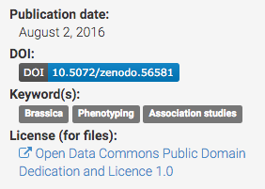
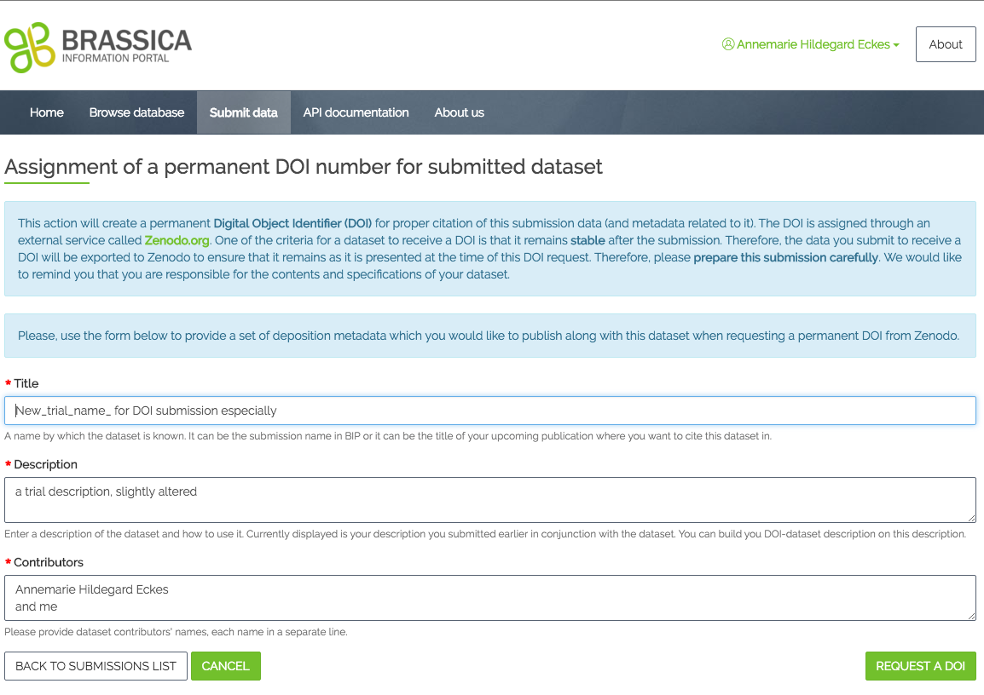
Obtaining a DOI through BIP
Request a digital object identifier for your dataset for easy citation in your publication:
Click “Request DOI”
Add additional metadata
Receive DOI instantly
Notes:
Latest developments were to obtain DOIs for datasets submitted to BIP. After 2 weeks of a dataset being published and not altered in the BIP, it is assumed to be “stable” and would be eligible for requesting a DOI. DOI is assigned through an external service called Zenodo.
- In your submissions, you can then request a DOI.
add some more metadata. Most of the metadata comes from the information you already gave when submitting to BIP. We have made most of the fields needed for a DOI submission already compulsory in the Trial submission process. It doesn’t need to be filled out twice. Some additional metadata is required according to DataCite standards.
instantly you receive the DOI and it is available and accessible online.
Once the data is submitted to Zenodo it cannot be changed. Therefore it is important to check the information submitted.

Slide 7
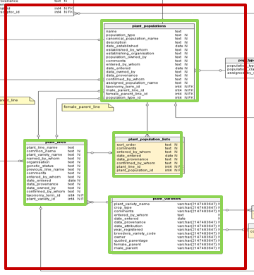
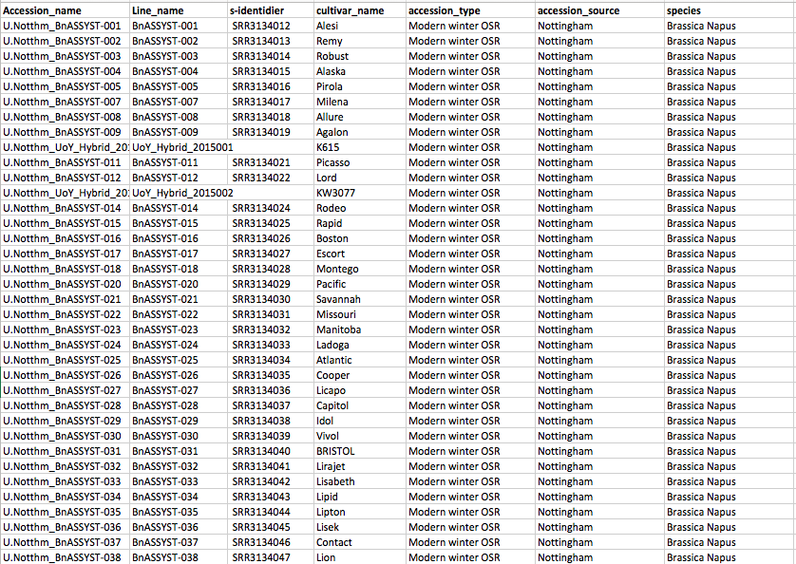
Automatised population submission using the ruby client
The ruby script
Your personal API key
(obtain from BIP)
Population_submission.rb
Reads the csv-file content
Creates records in the database and
Submits the data content to the database using the API
.csv -input

Slide 8
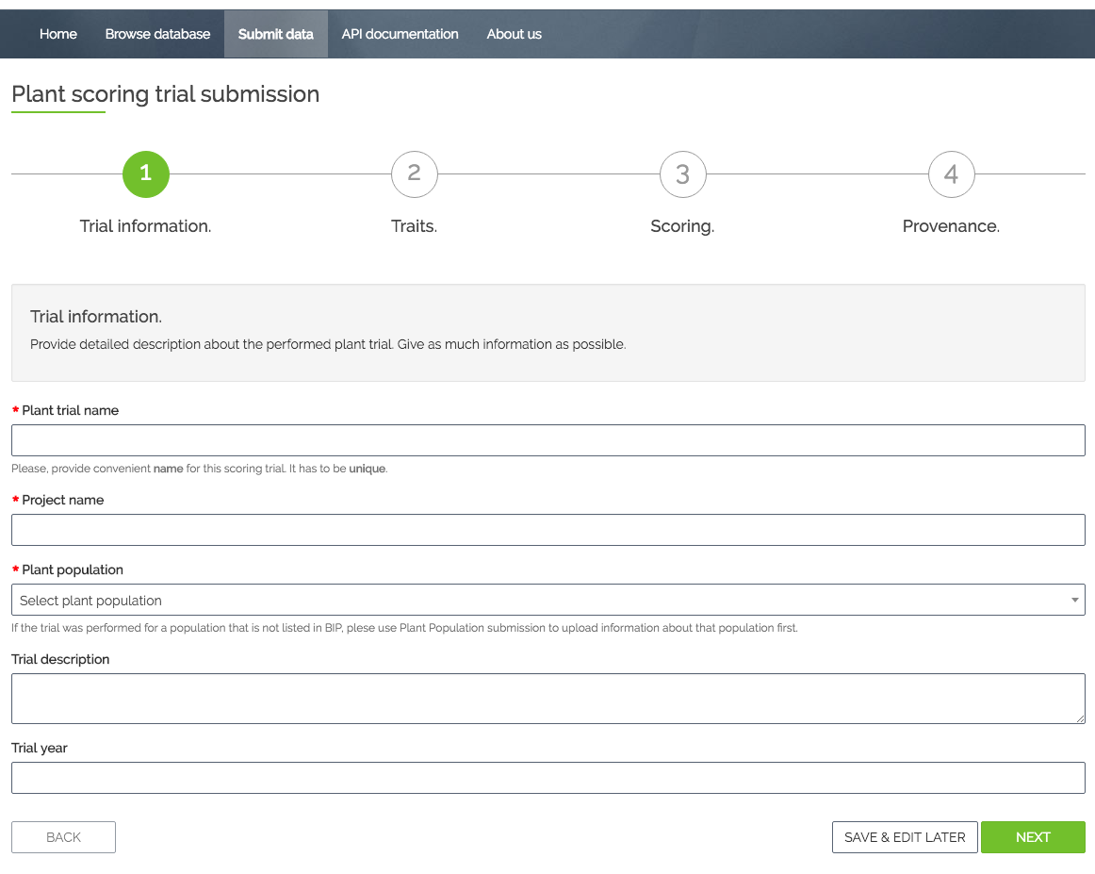
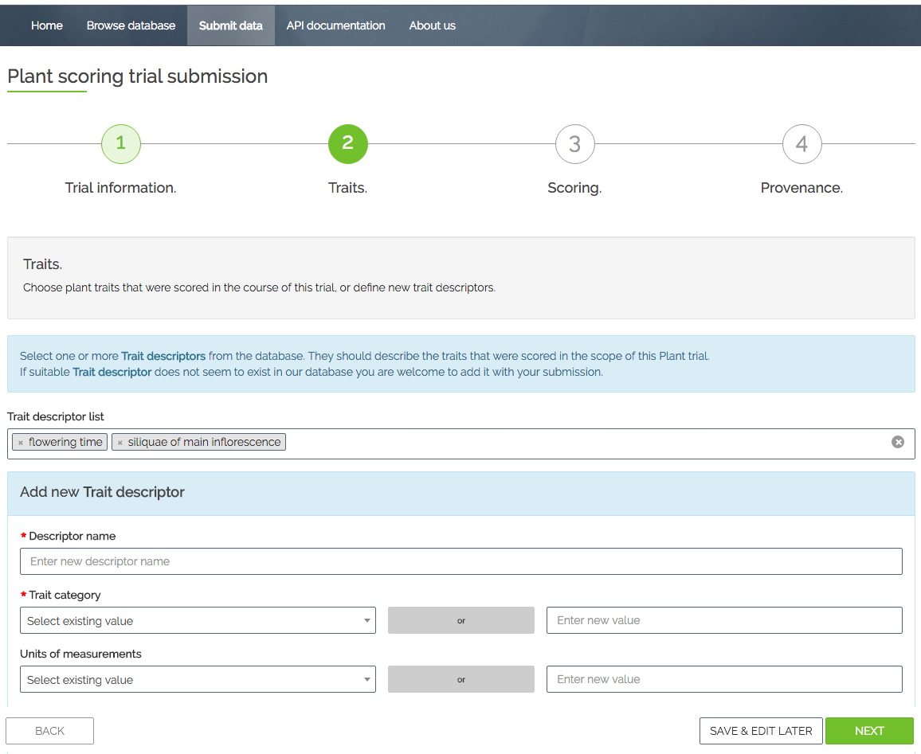
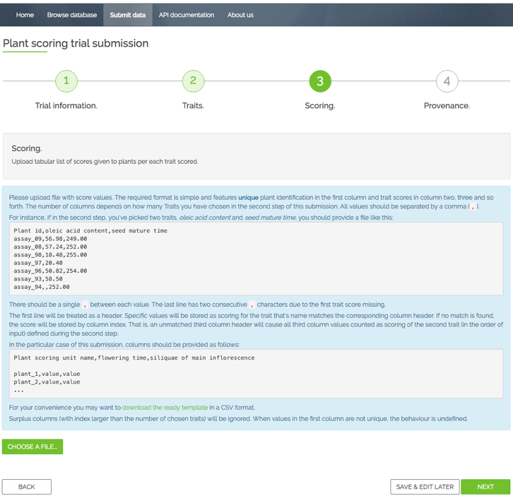
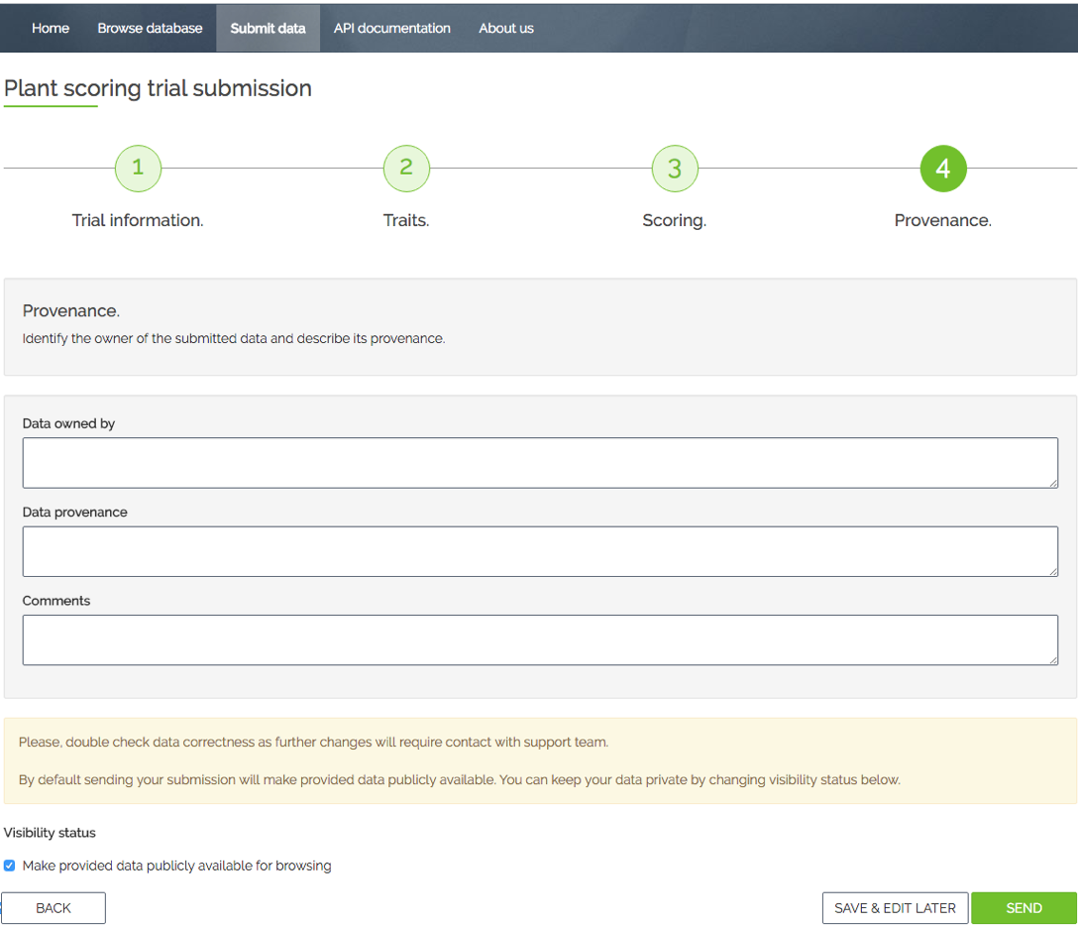
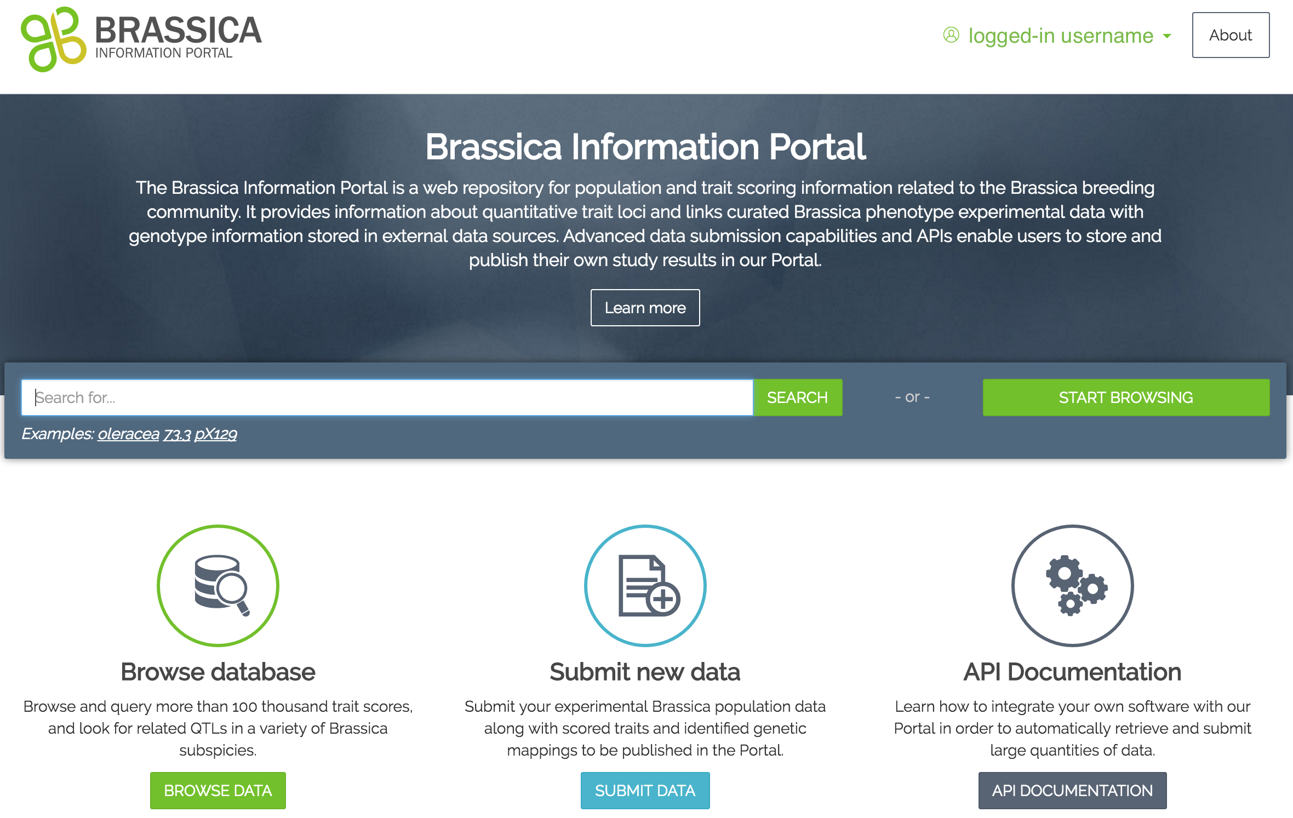
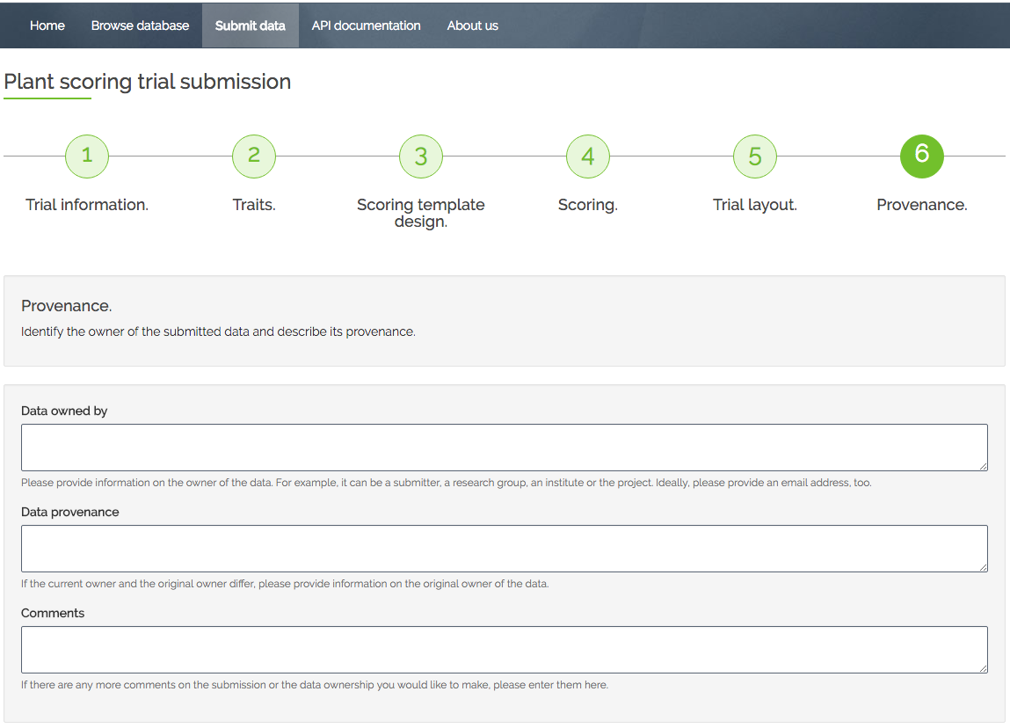
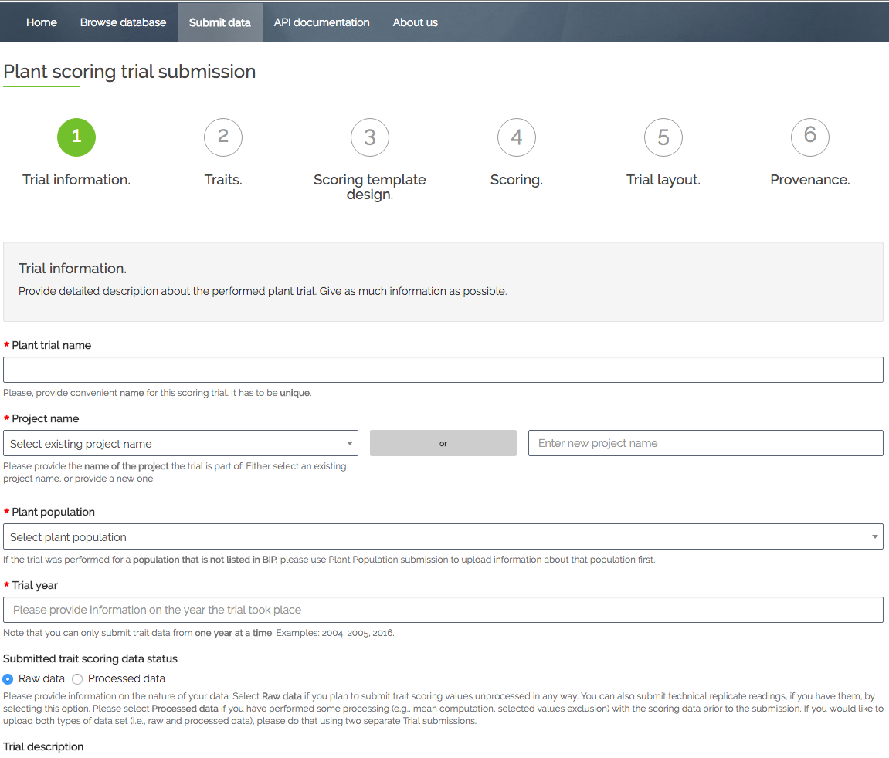
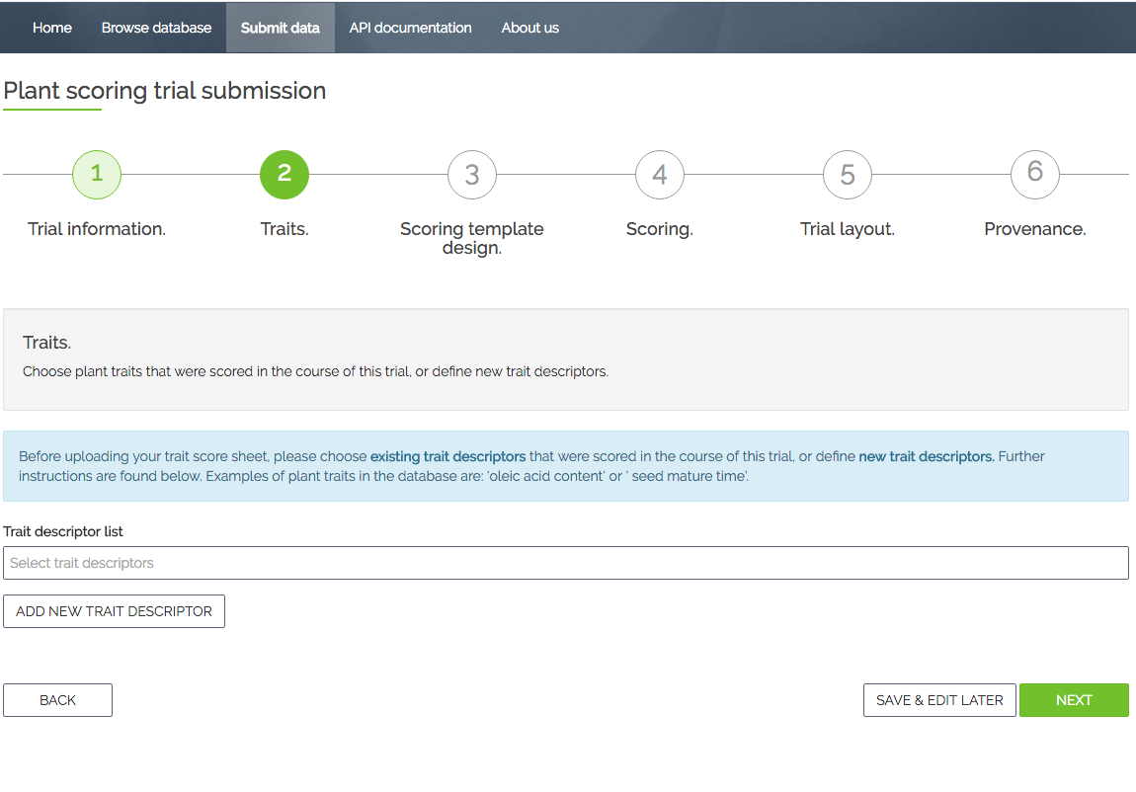
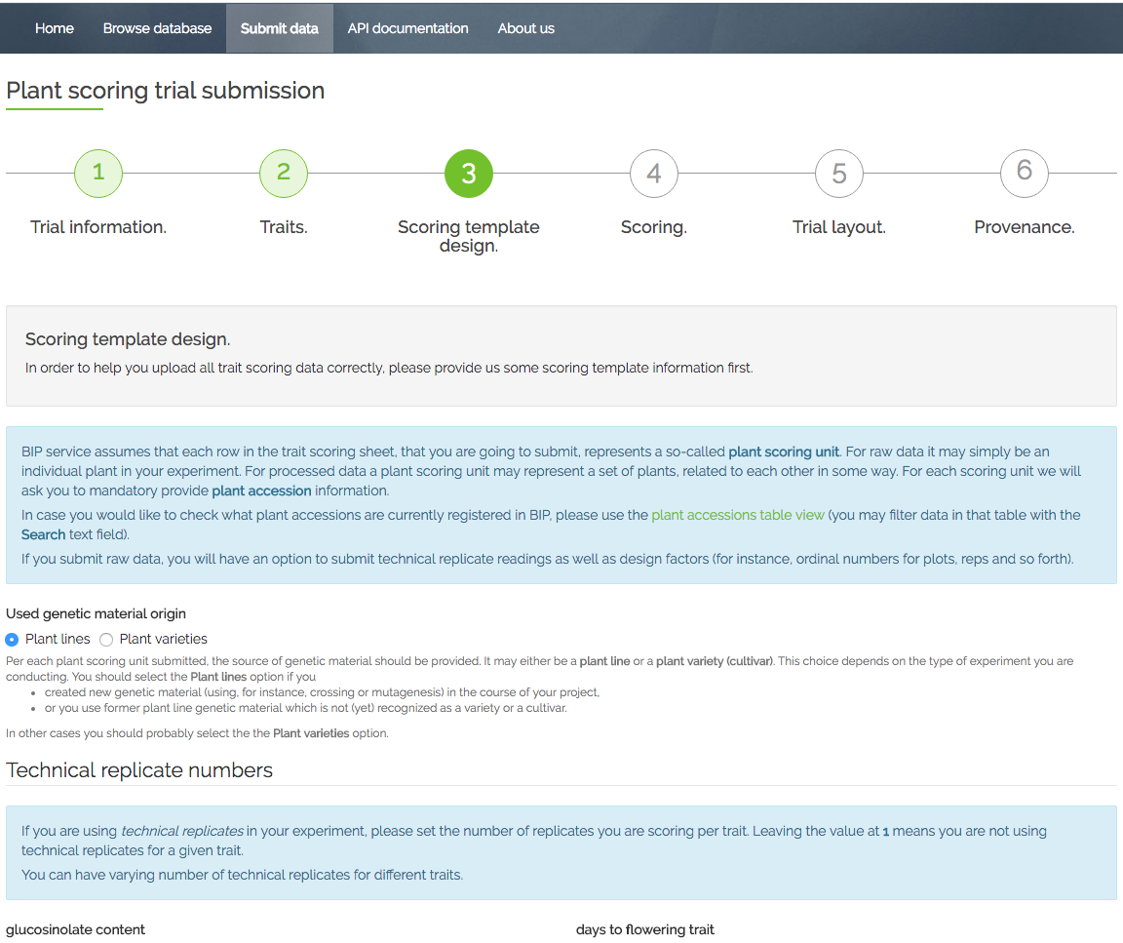
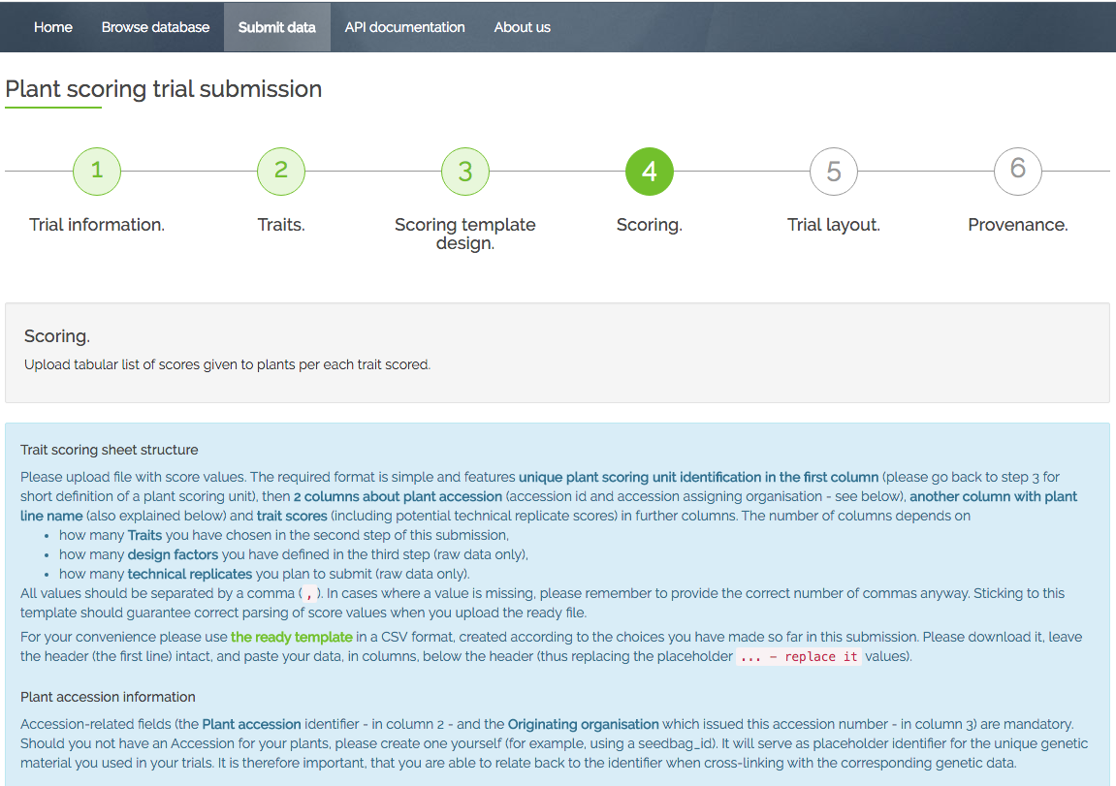
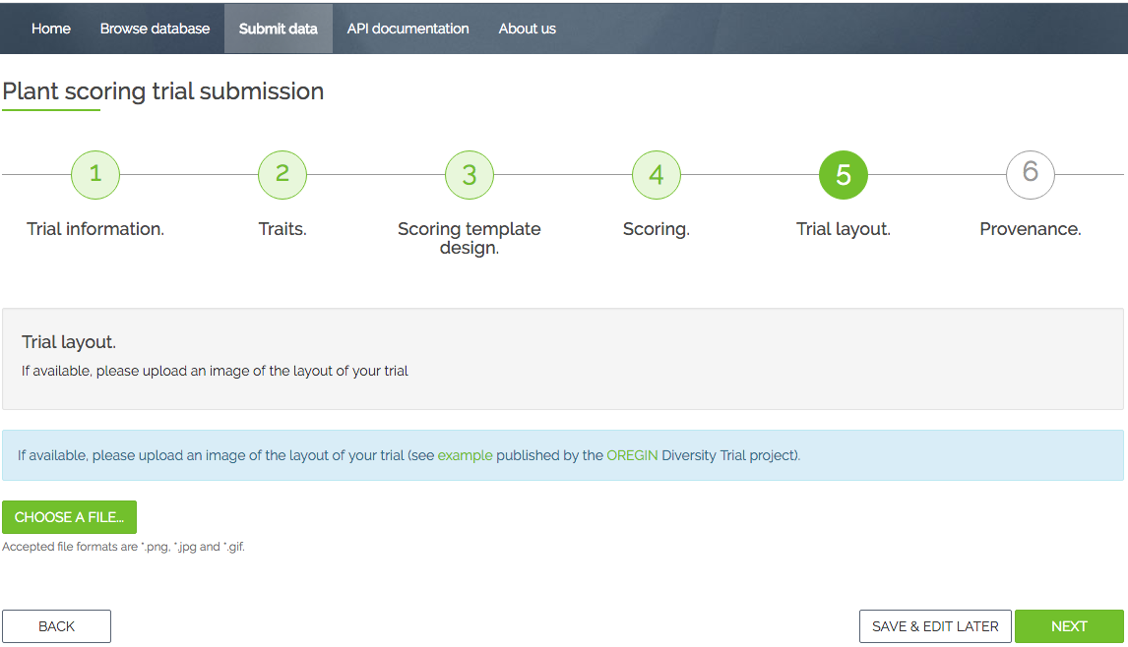
Extended Trial submission using the wizard
A
Provenance
Trial Information
Traits
Scoring submission
Scoring
Template submission
Trial Layout
Provenance
Traits
Scoring
Template design
Trial Information
B

Slide 9

The Brassica Information Portal in the Research Cycle
Identify pot. collaborators
Meta analysis of data content
Research question
Finding communication
Study design
Get inspired by existing studies
Perform associative analysis with cross-linked genotypic information
Define and submit the traits
( new Ontology terms)
Data analysis
Data collection
Data submission
Perform on-the-fly statistical analysis of raw data and compare with existing studies
Have metadata and trait data ready
Notes:
All possible interactions the Brassica Information Portal can have with the Research Cycle in plant breeding research.
The Portal can be integrated in all aspects of Brassica research from generating a research question and collaborations from selecting or defining new traits to measure, through data handling and storage to associative analysis.
Also a summary slide for what I have done and future developments.

Slide 10
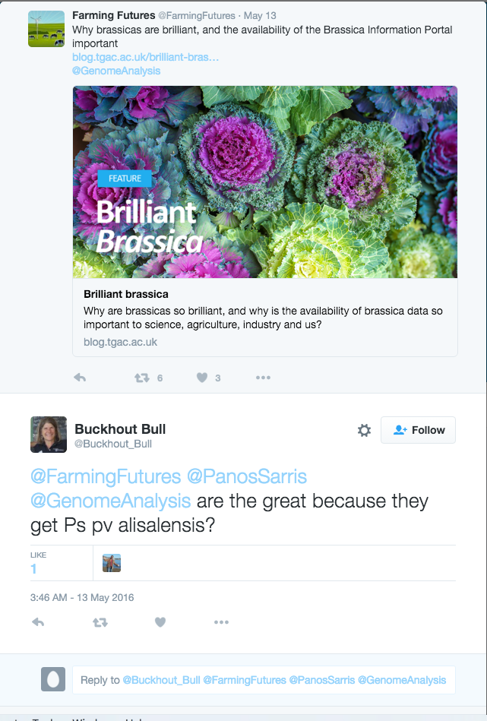
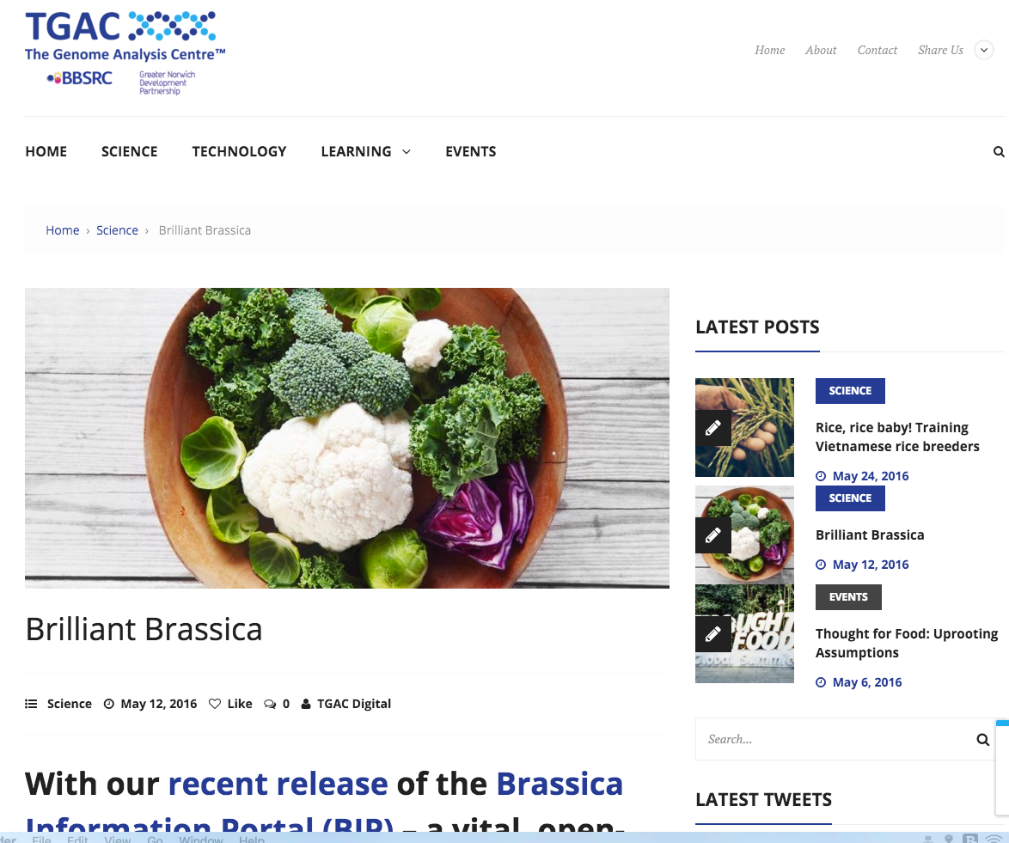
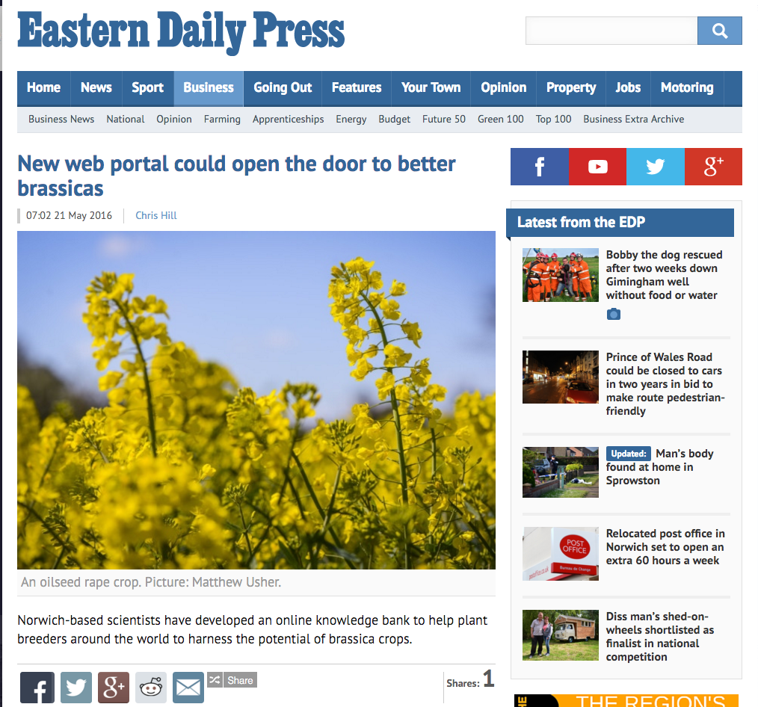

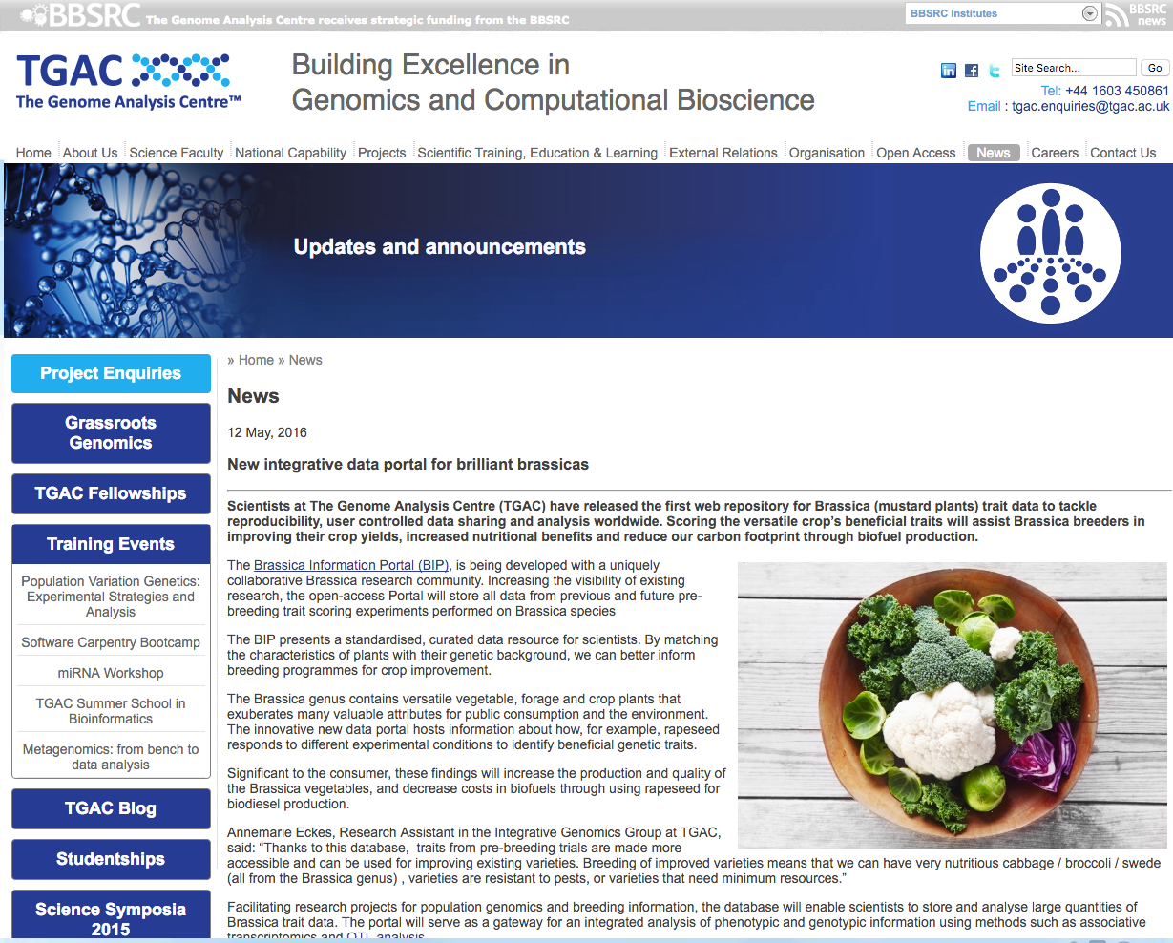
in the media
Notes:
Ontologies for the BIP are important for harmonizing the annotation of phenotypic
-> to support data accessibility and discovery.
Lack of standards in nomenclature in Brassica. -> needs to be identified, discussed, improved, reviewed.
“Without either a nomenclature or information, which provides the equivalence links between trait descriptions, it is hard to compare information from Quantitative Trait Loci (QTL) and association studies in a way that permits systematic transfer of knowledge about genotype-phenotype relationships among crops or between crops. “
A successful implementation of Ontologies for Brassica will facilitates comparison
Systematic knowledge transfer about genotype-phenotype relationships among brassica.

Slide 11
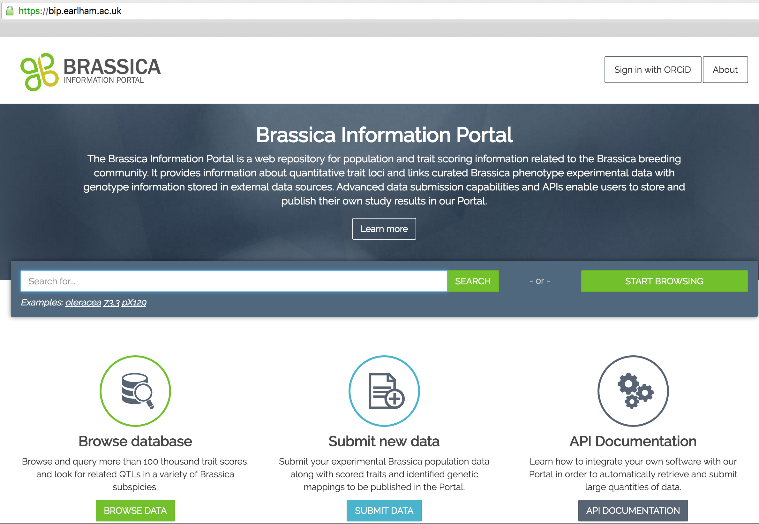
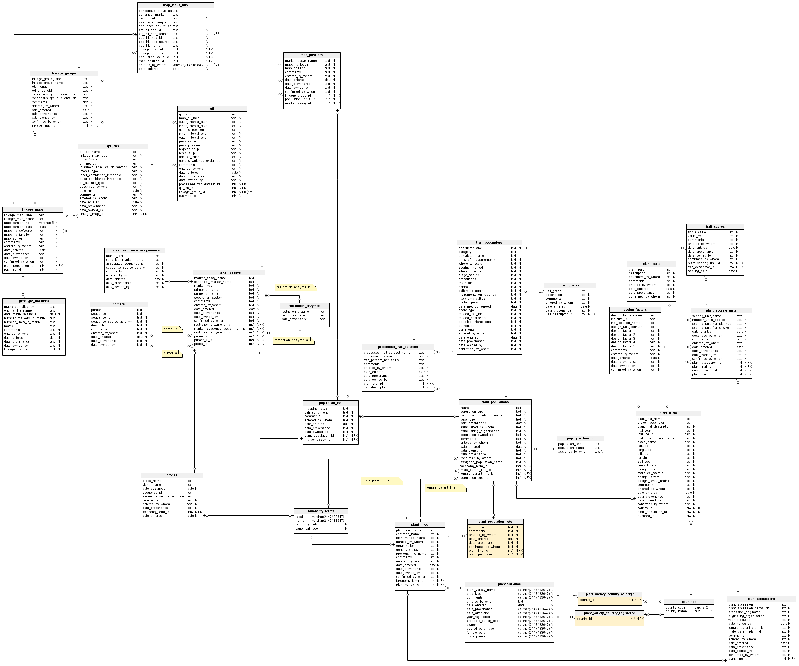
Data upload to BIP
The Brassica Information Portal interface and underlying schema

Slide 12
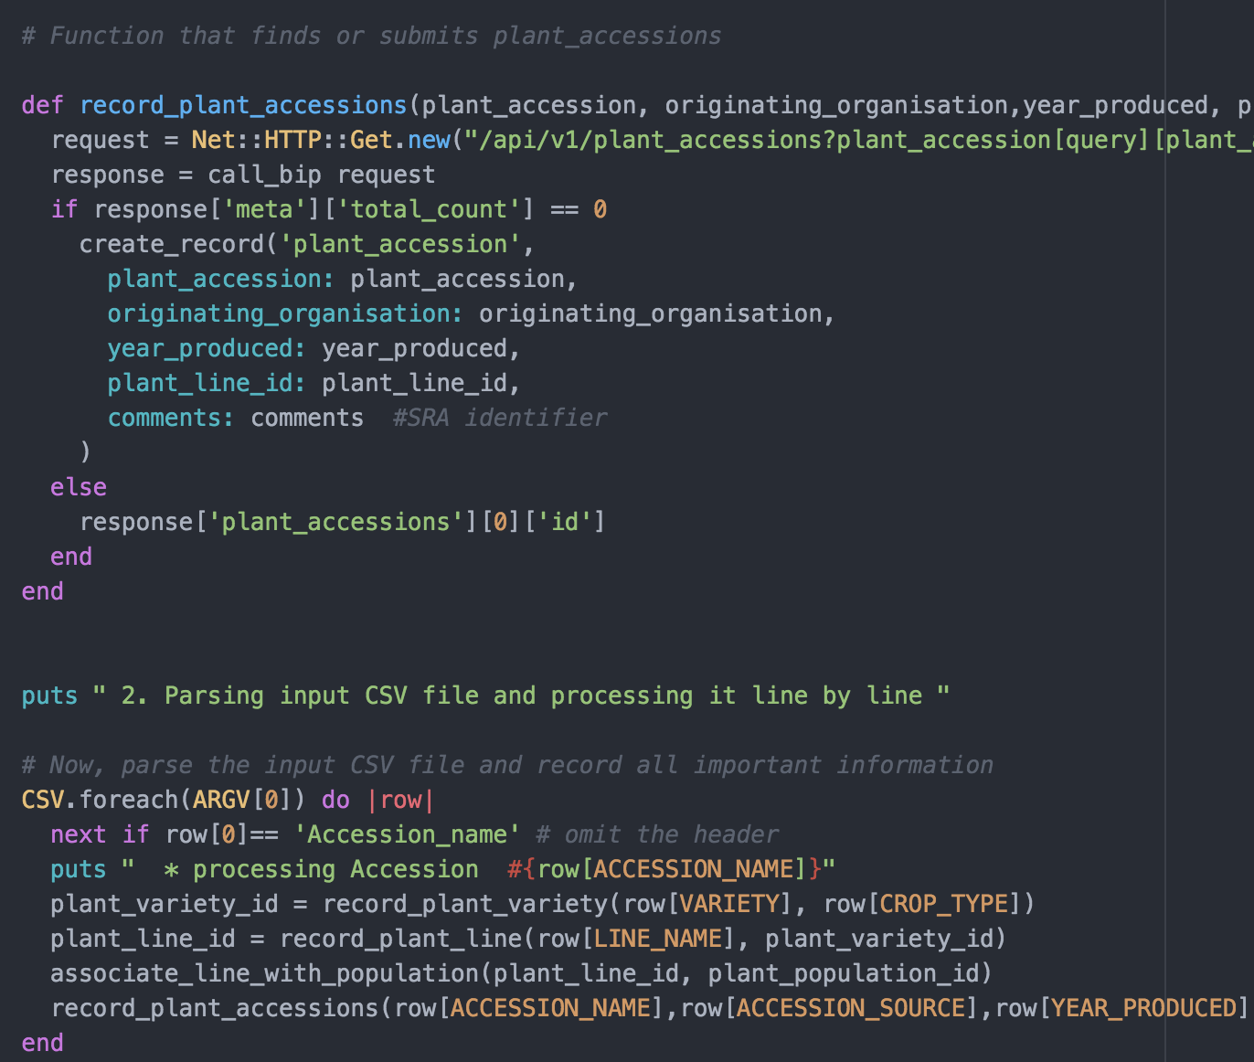
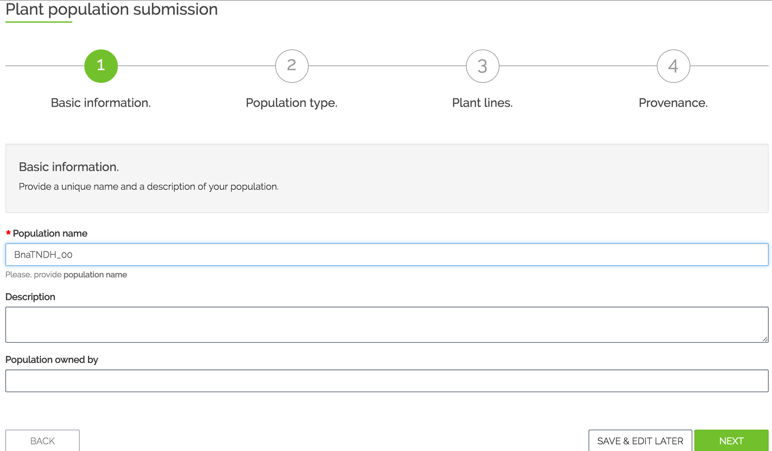
The BIP database schema
Trial Submission
Population Submission

Slide 13
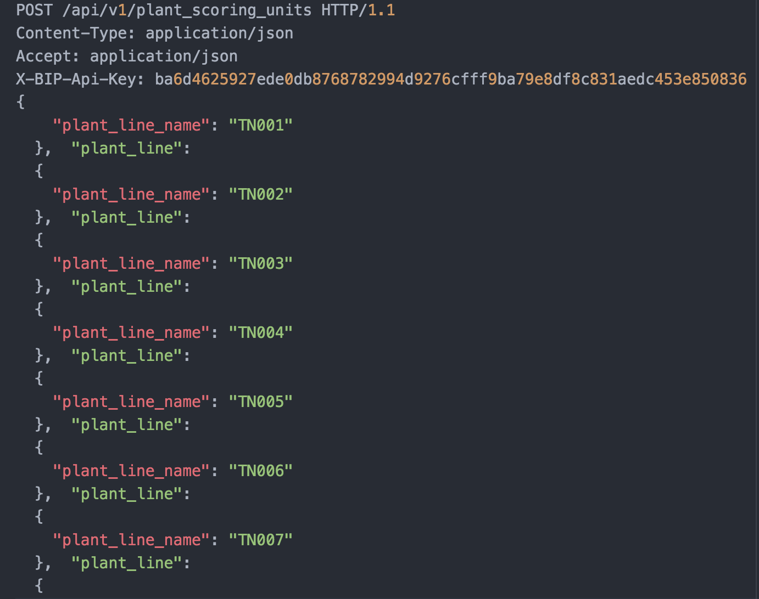
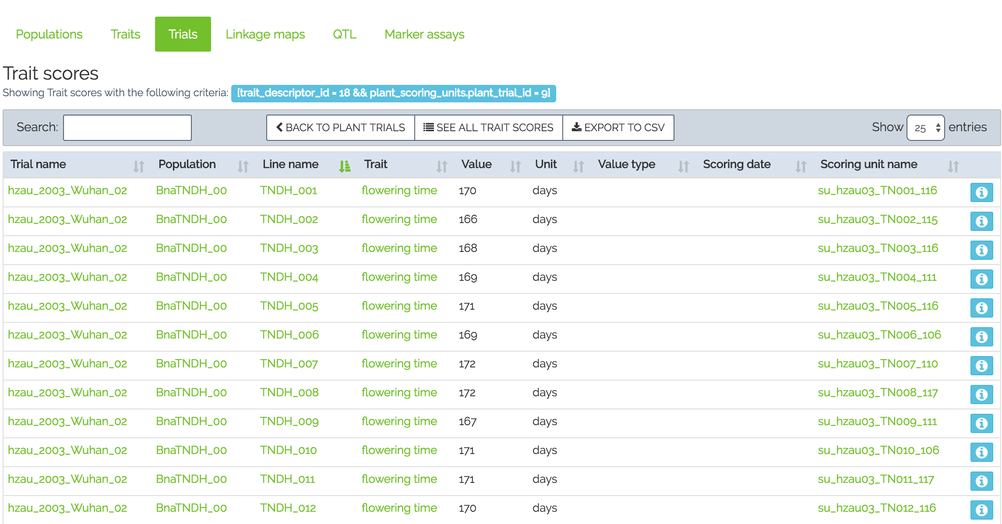
Different ways to communicate with the BIP
Programmatic submission – Population Submission
API layer
Web layer
Wizard based – Trial Submission
HTTPS

Slide 14
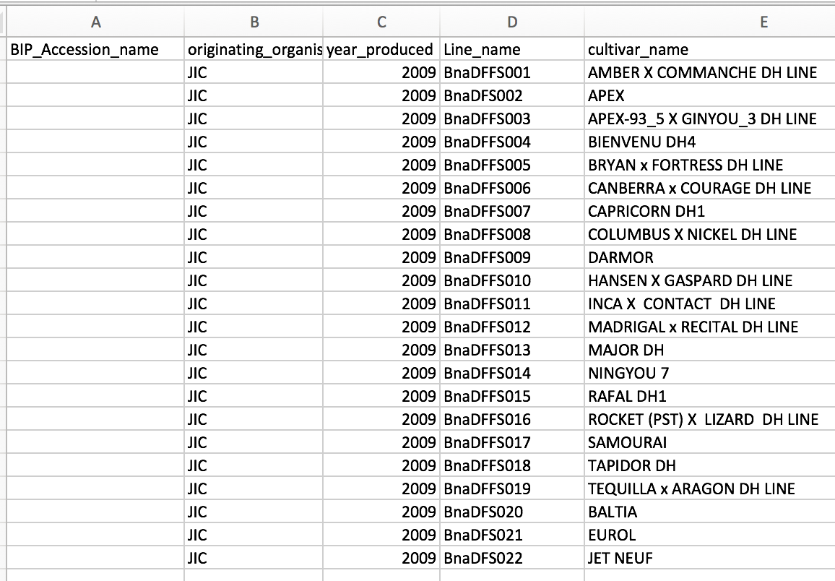
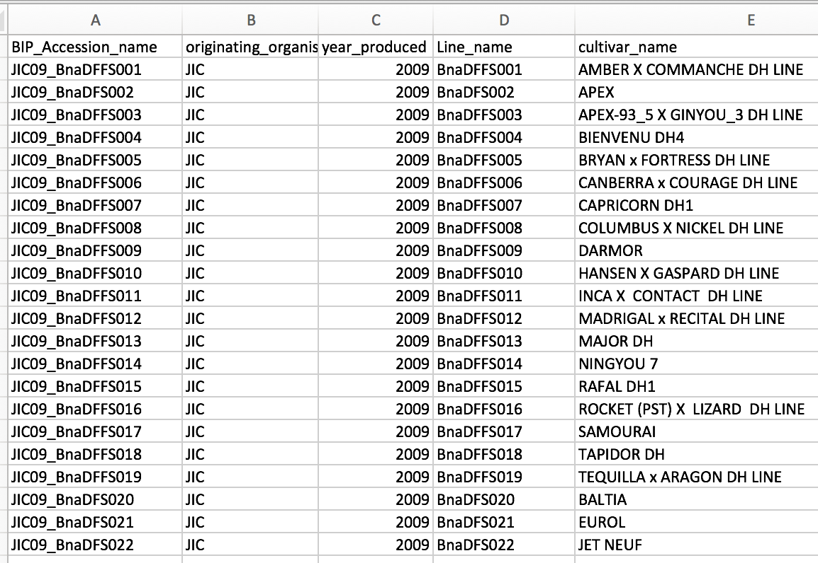
Population Submission using the ruby client
Population metadata
Diversity fixed foundation set -> line names
Seed bulked up at JIC in 2009
Assign identifier to the germplasm used
Nomenclature:
<Institute abb4><YY>_<line name>
FILE: 1_BnaDFFS.csv
Notes:
Genetic drift/ selection/ cross-pollination/other problems could happen during bulking and the material may not be as “clean” as one thinks. Therefore, the accessions in the BIP are there to record

Slide 15
33 different lines
3 reps
2 polytunnels

Slide 16
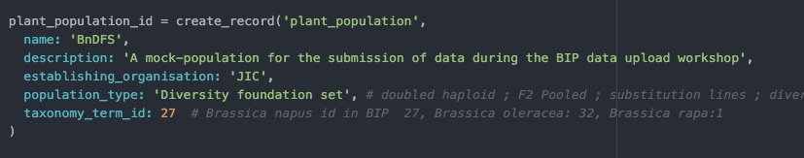
Population Submission
Help from the ruby client:
Population_submission.rb

Slide 17
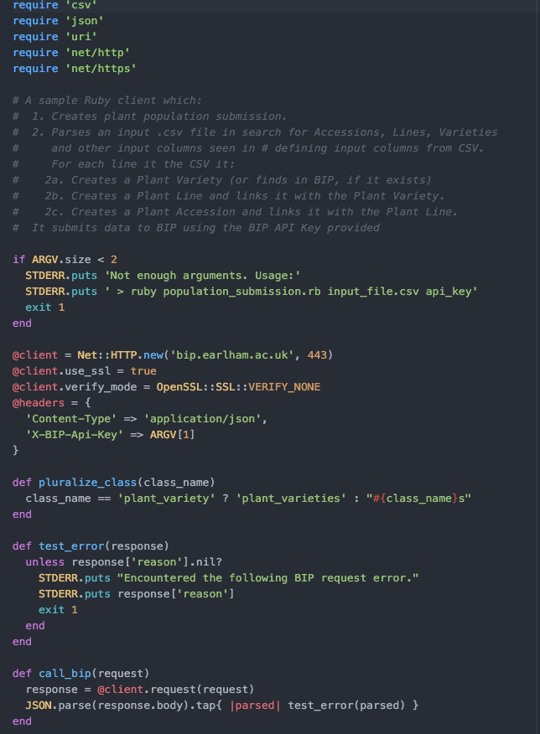
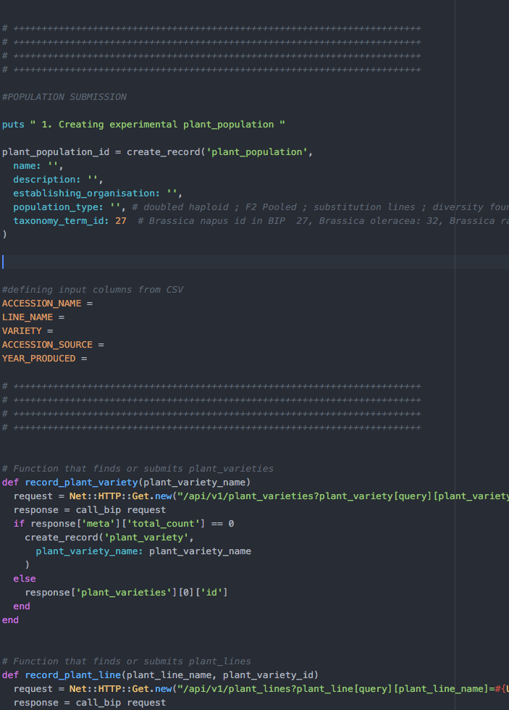
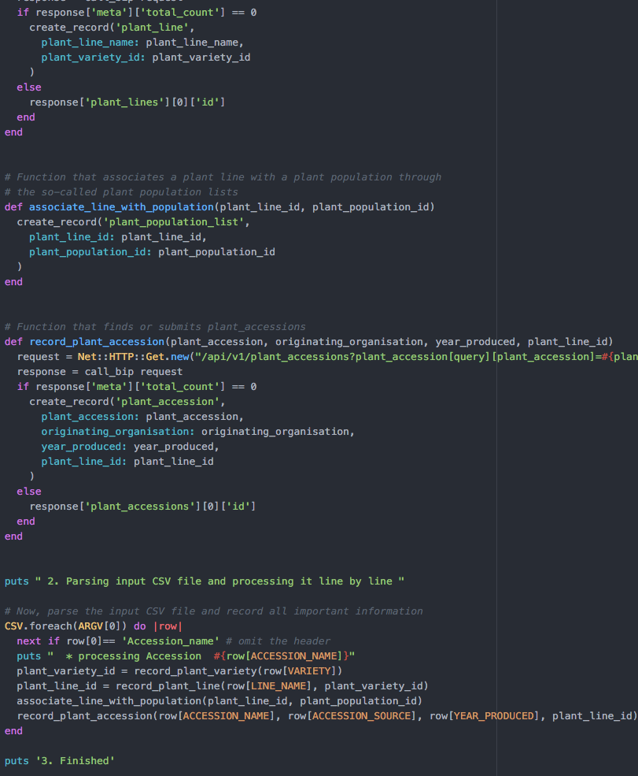
Population Submission using the ruby client
“Header”
Loads software , “dials into database”, defines urls, parameters, error messages
Functions
to fill database tables with content from the .csv –file
-”create_record”
plant population, plant lines, plant varieties, plant accessions
“Body”
FILE:
2_Population_submission.rb
Run functions

Slide 18
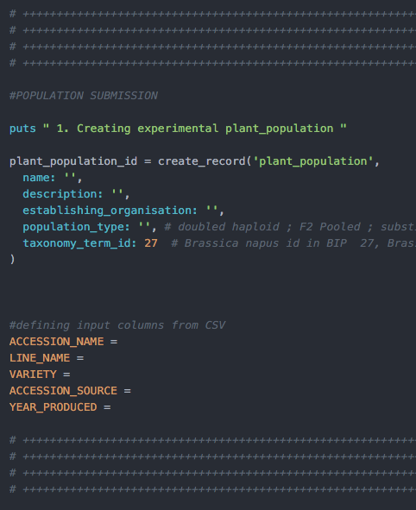
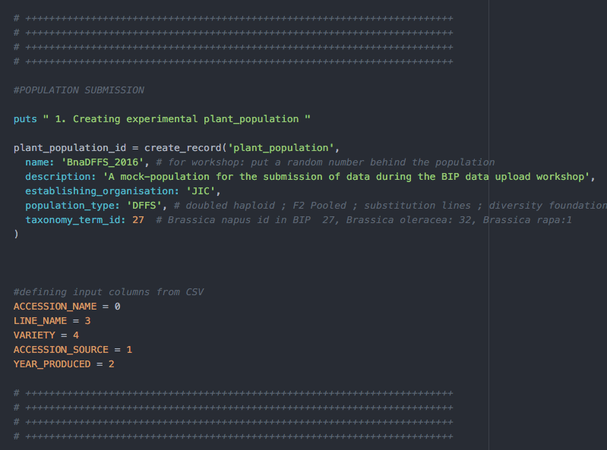
Population submission -defining input columns from your CSV
Notes:
Latest developments were to obtain DOIs for datasets submitted to BIP. After 2 weeks of a dataset being published and not altered in the BIP, it is assumed to be “stable” and would be eligible for requesting a DOI. DOI is assigned through an external service called Zenodo.
- In your submissions, you can then request a DOI.
add some more metadata. Most of the metadata comes from the information you already gave when submitting to BIP. We have made most of the fields needed for a DOI submission already compulsory in the Trial submission process. It doesn’t need to be filled out twice. Some additional metadata is required according to DataCite standards.
instantly you receive the DOI and it is available and accessible online.
Once the data is submitted to Zenodo it cannot be changed. Therefore it is important to check the information submitted.

Slide 19
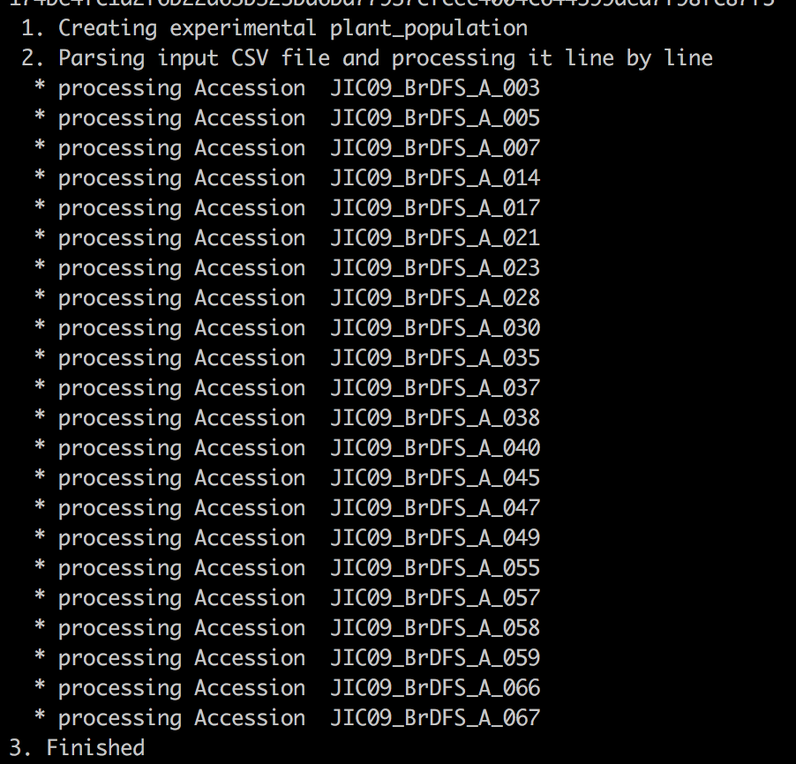
Population submission -run the script
Retrieve API (key) – look in manual for how to find it
Run the script:
ruby population_submission.rb <your_input_file.csv> <your_api_key>
Ruby population_submission.rb 1_BnaDFFS aslsb4js4k1ls04g1lkjiu131409sglkh1394k
Notes:
Latest developments were to obtain DOIs for datasets submitted to BIP. After 2 weeks of a dataset being published and not altered in the BIP, it is assumed to be “stable” and would be eligible for requesting a DOI. DOI is assigned through an external service called Zenodo.
- In your submissions, you can then request a DOI.
add some more metadata. Most of the metadata comes from the information you already gave when submitting to BIP. We have made most of the fields needed for a DOI submission already compulsory in the Trial submission process. It doesn’t need to be filled out twice. Some additional metadata is required according to DataCite standards.
instantly you receive the DOI and it is available and accessible online.
Once the data is submitted to Zenodo it cannot be changed. Therefore it is important to check the information submitted.

Slide 20
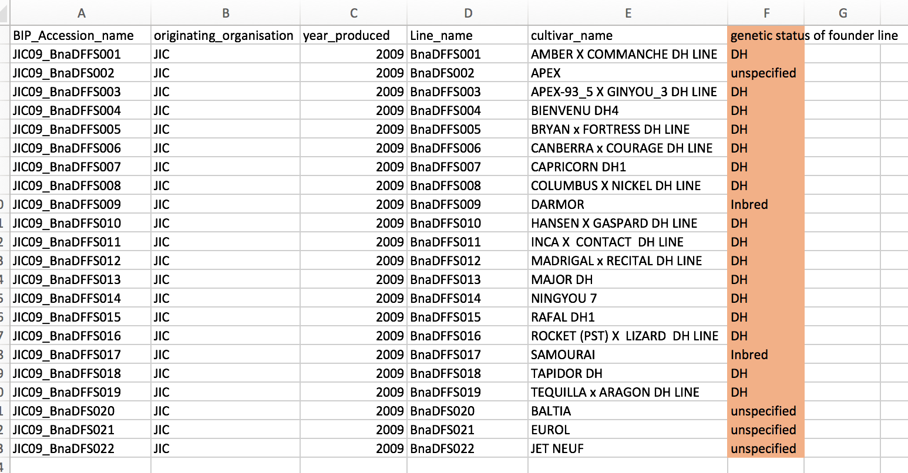
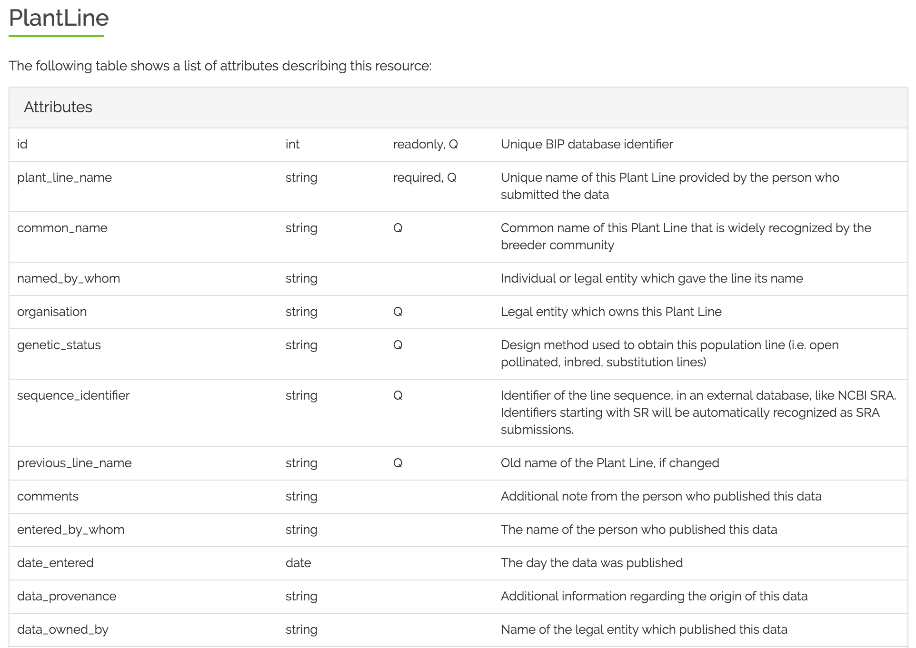
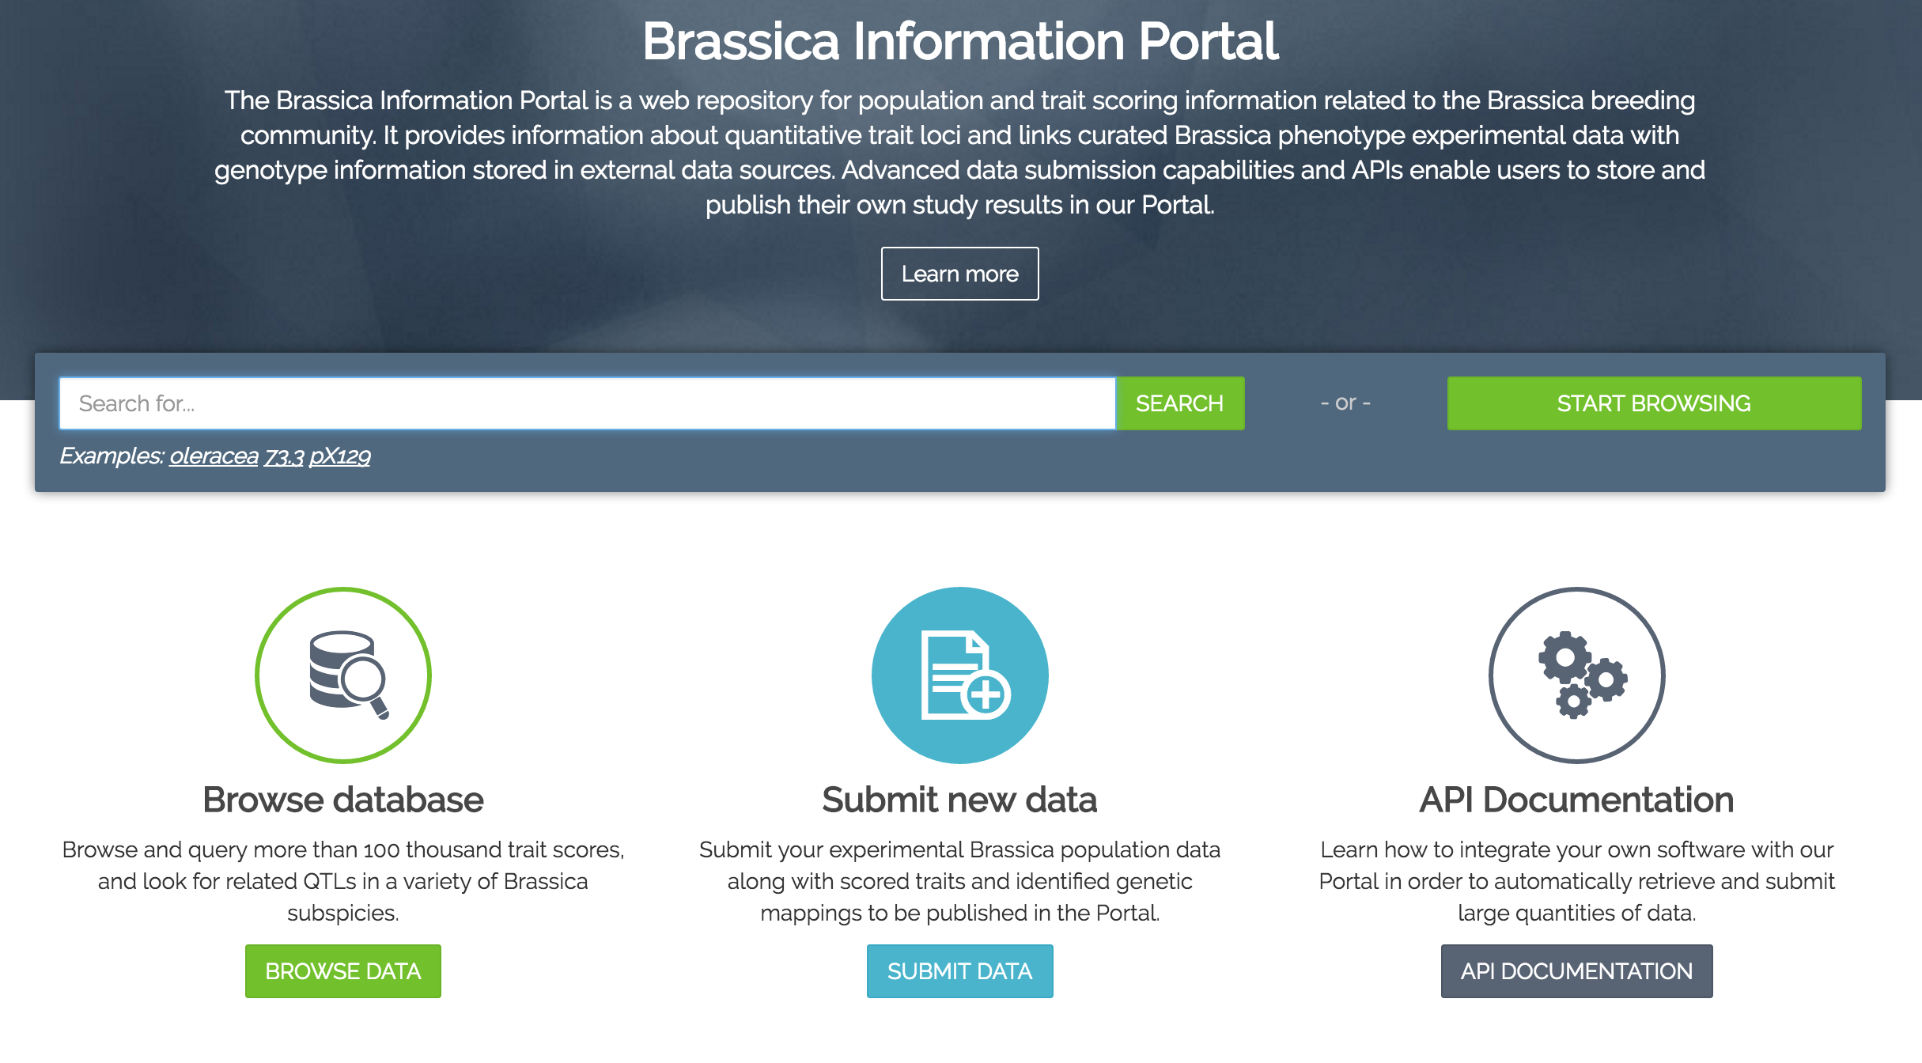
Population submission - extension -altering the ruby client
More metadata about the population
Alter ruby client accordingly
Open 2_population_submission.rb
FILE: 3_population_submissionBna_genstatus

Slide 21
Population submission -altering the ruby client
Open 2_population_submission.rb
Notes:
Latest developments were to obtain DOIs for datasets submitted to BIP. After 2 weeks of a dataset being published and not altered in the BIP, it is assumed to be “stable” and would be eligible for requesting a DOI. DOI is assigned through an external service called Zenodo.
- In your submissions, you can then request a DOI.
add some more metadata. Most of the metadata comes from the information you already gave when submitting to BIP. We have made most of the fields needed for a DOI submission already compulsory in the Trial submission process. It doesn’t need to be filled out twice. Some additional metadata is required according to DataCite standards.
instantly you receive the DOI and it is available and accessible online.
Once the data is submitted to Zenodo it cannot be changed. Therefore it is important to check the information submitted.

Slide 22
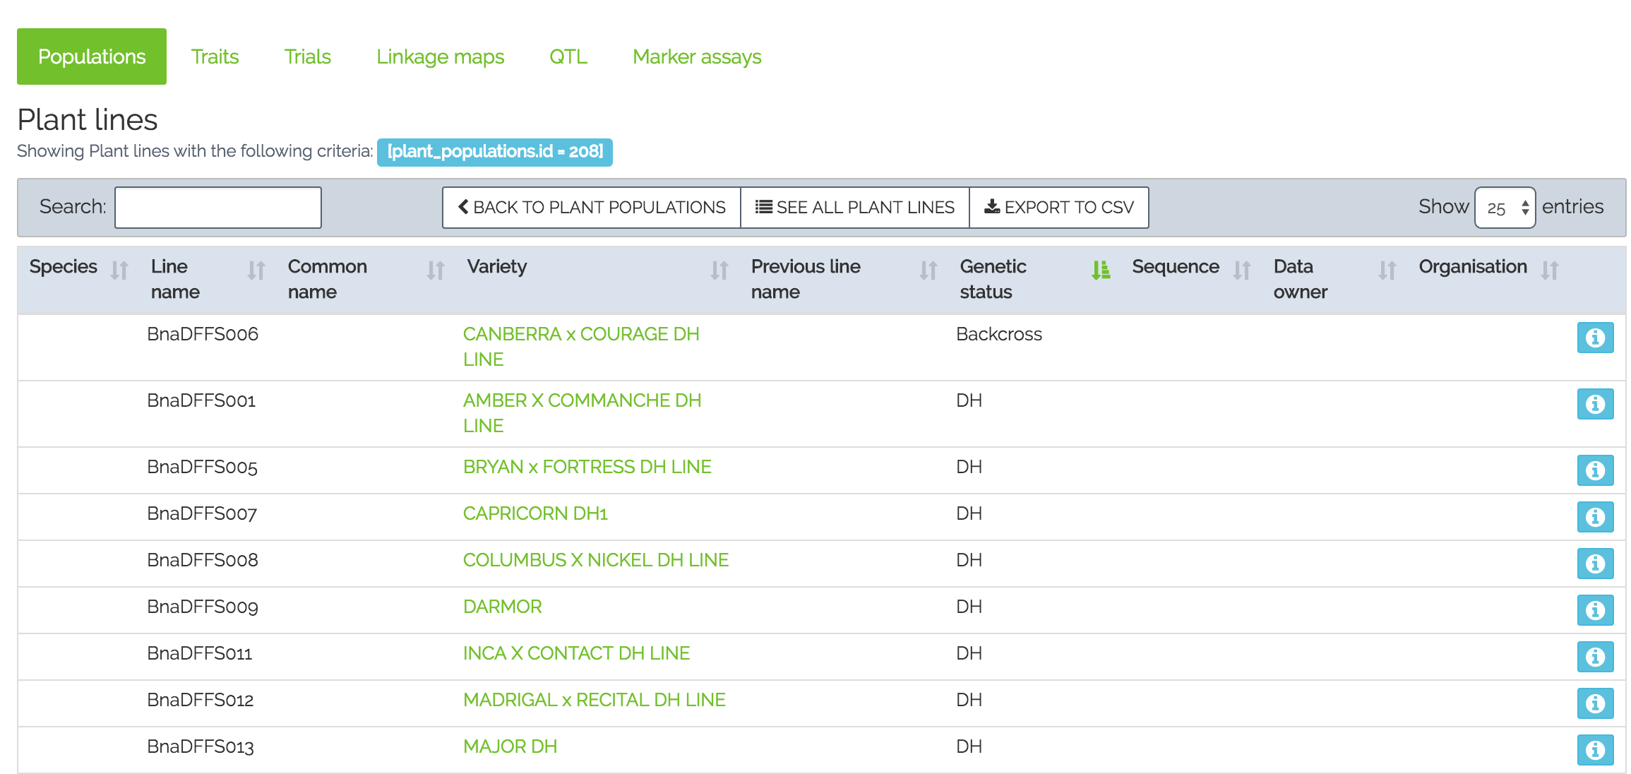
Population submission
Successful submission of a population, altering the ruby client to add submission of the ‘genetic status’ information
Notes:
Latest developments were to obtain DOIs for datasets submitted to BIP. After 2 weeks of a dataset being published and not altered in the BIP, it is assumed to be “stable” and would be eligible for requesting a DOI. DOI is assigned through an external service called Zenodo.
- In your submissions, you can then request a DOI.
add some more metadata. Most of the metadata comes from the information you already gave when submitting to BIP. We have made most of the fields needed for a DOI submission already compulsory in the Trial submission process. It doesn’t need to be filled out twice. Some additional metadata is required according to DataCite standards.
instantly you receive the DOI and it is available and accessible online.
Once the data is submitted to Zenodo it cannot be changed. Therefore it is important to check the information submitted.

Slide 23

Trial submission
Plant population metadata:
Define name
Description
Establishing organisation
Population_type
Taxonomy_term_id:
Notes:
Latest developments were to obtain DOIs for datasets submitted to BIP. After 2 weeks of a dataset being published and not altered in the BIP, it is assumed to be “stable” and would be eligible for requesting a DOI. DOI is assigned through an external service called Zenodo.
- In your submissions, you can then request a DOI.
add some more metadata. Most of the metadata comes from the information you already gave when submitting to BIP. We have made most of the fields needed for a DOI submission already compulsory in the Trial submission process. It doesn’t need to be filled out twice. Some additional metadata is required according to DataCite standards.
instantly you receive the DOI and it is available and accessible online.
Once the data is submitted to Zenodo it cannot be changed. Therefore it is important to check the information submitted.

Slide 24
Population submission -the ruby client
Plant population metadata:
Define name
Description
Establishing organisation
Population_type
Taxonomy_term_id:
Notes:
Latest developments were to obtain DOIs for datasets submitted to BIP. After 2 weeks of a dataset being published and not altered in the BIP, it is assumed to be “stable” and would be eligible for requesting a DOI. DOI is assigned through an external service called Zenodo.
- In your submissions, you can then request a DOI.
add some more metadata. Most of the metadata comes from the information you already gave when submitting to BIP. We have made most of the fields needed for a DOI submission already compulsory in the Trial submission process. It doesn’t need to be filled out twice. Some additional metadata is required according to DataCite standards.
instantly you receive the DOI and it is available and accessible online.
Once the data is submitted to Zenodo it cannot be changed. Therefore it is important to check the information submitted.

Slide 25

BIP user example
Programmatic and wizard based data submission
Location: China, Weinan
Population: DH segregating
population of 202 lines
(Tapidor x Ningyou7) (Qiu et al. 2006)
Trait: Flowering time
Notes:
This is an old slide which acts as a placeholder for an updated version. It needs to be updated based on the last developments.

Slide 26




User case 1) Submission types
Programmatic submission
Wizard submission
Notes:
This is an old slide which acts as a placeholder for an updated version. It needs to be updated based on the last developments.

Slide 27

Publication with BIP as repository
Notes:
This is an old slide which acts as a placeholder for an updated version. It needs to be updated based on the last developments.

Slide 28



User case 2) data download
Mapping (mapQTL)
- Associative transcriptomics
Via the website
Programmatically
( API)
Notes:
This is an old slide which acts as a placeholder for an updated version. It needs to be updated based on the last developments.

Slide 29







Sarah Ayling
Wiktor Jurkowski
Tim Stitt
Anil Thanki
Robert Davey
Tomasz Gubała
Piotr Nowakowski
Tomek Szymczyszyn
Bartosz Chucherko
Erik Van den Bergh
Ramona Walls
Ambrose Andongabo
Pierre Carrion
Keywan Hassani-Pak
Chris Rawlings
Hanna Ćwiek, TransPlant
Ian Bancroft
Lenka Havlickowa
Zhesi He
Ian wood
RIPR
Acknowledgements
Graham King
Rachel Wells Judith Irwin
Dan Bolser
Guy Naamati

Slide 30
Annemarie Eckes
Data Curation, Plant Phenotyping
Annemarie.Eckes@earlham.ac.uk
@BrassicaPortal

